Slide 1
Search for Dark Matter produced in association with a Higgs boson in proton–proton collisions at $√s$= 13 TeV
Ashim Roy
B. N. Mandal University, Madhepura, India
On behalf of CMS Collaboration
ICHEPAP Conference Talk at SINP, Kolkata, December 11, 2023

Slide 2
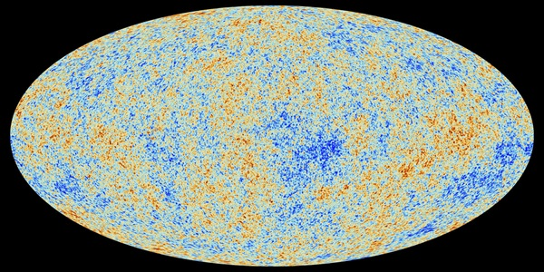
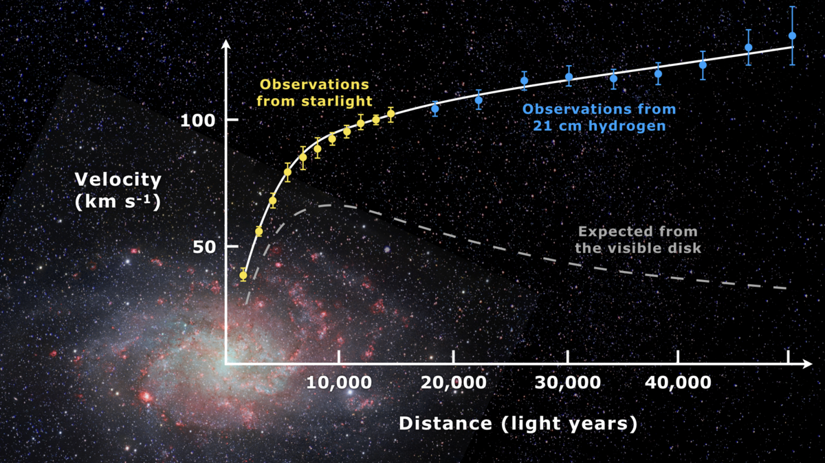
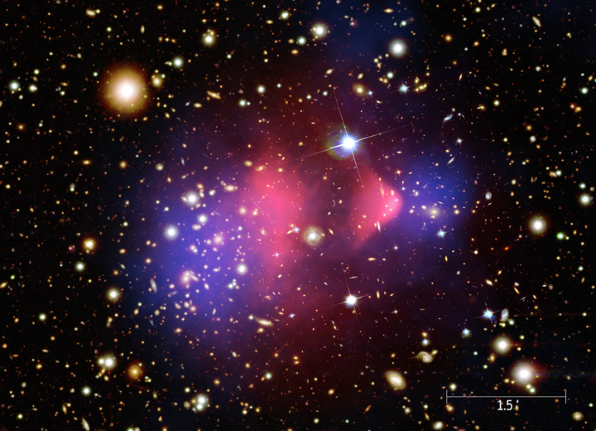
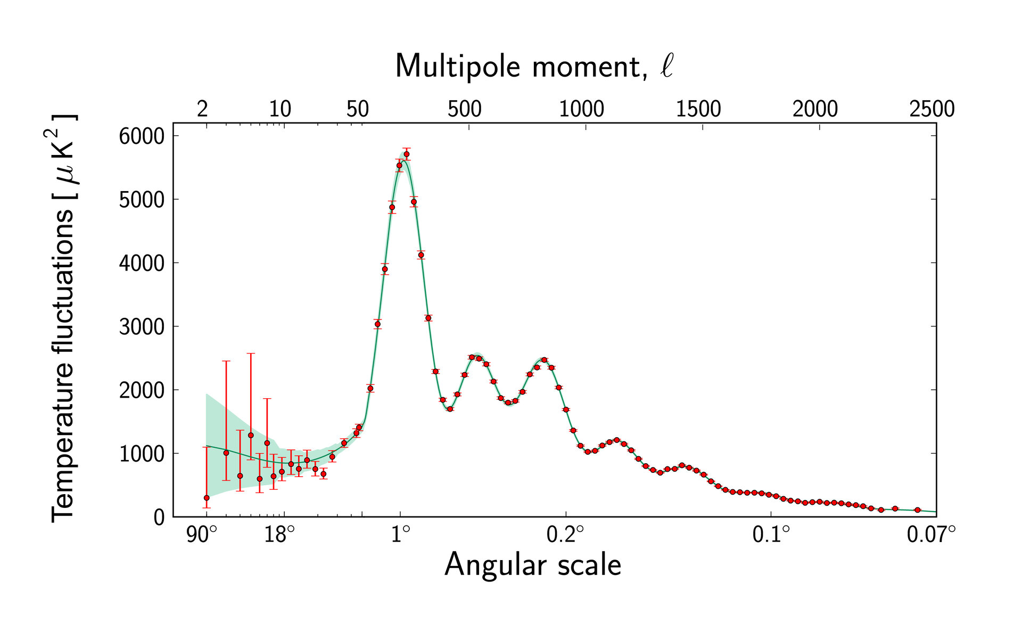
Why do we talk about dark matter?
Evidences of Dark Matter
Rotatonal Curve of Spiral Galaxy Messier 33
Bullet Cluster
CMB Radiation
https://en.wikipedia.org/wiki/File:Rotation_curve_of_spiral_galaxy_Messier_33_(Triangulum).png
https://chandra.harvard.edu/photo/2006/1e0657/more.html
https://www.esa.int/ESA_Multimedia/Images/2013/03/Planck_Power_Spectrum

Slide 4
What is Dark Matter?

Slide 5
What is Dark Matter?
What is the nature of Dark Matter? What are the fundamental constituents of Dark Matter?

Slide 6
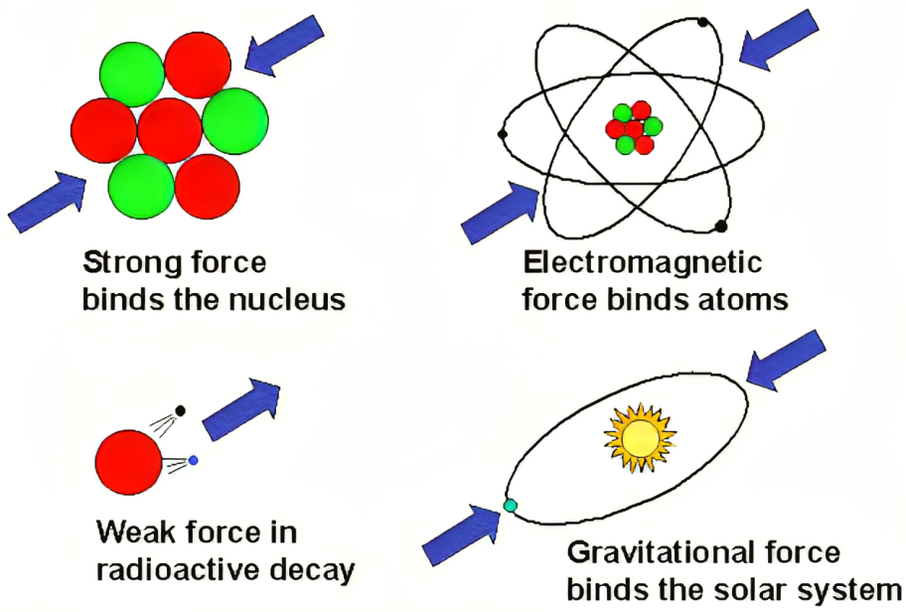
The Four Forces of Nature

Slide 7
Electromagnetic Force
Strong Force
Unstable
A possible candidate of DM can be thought of as WIMP,
Weekly Interacting Massive Particle.
too fast moving or hot for making so much of the dark matter

Slide 8
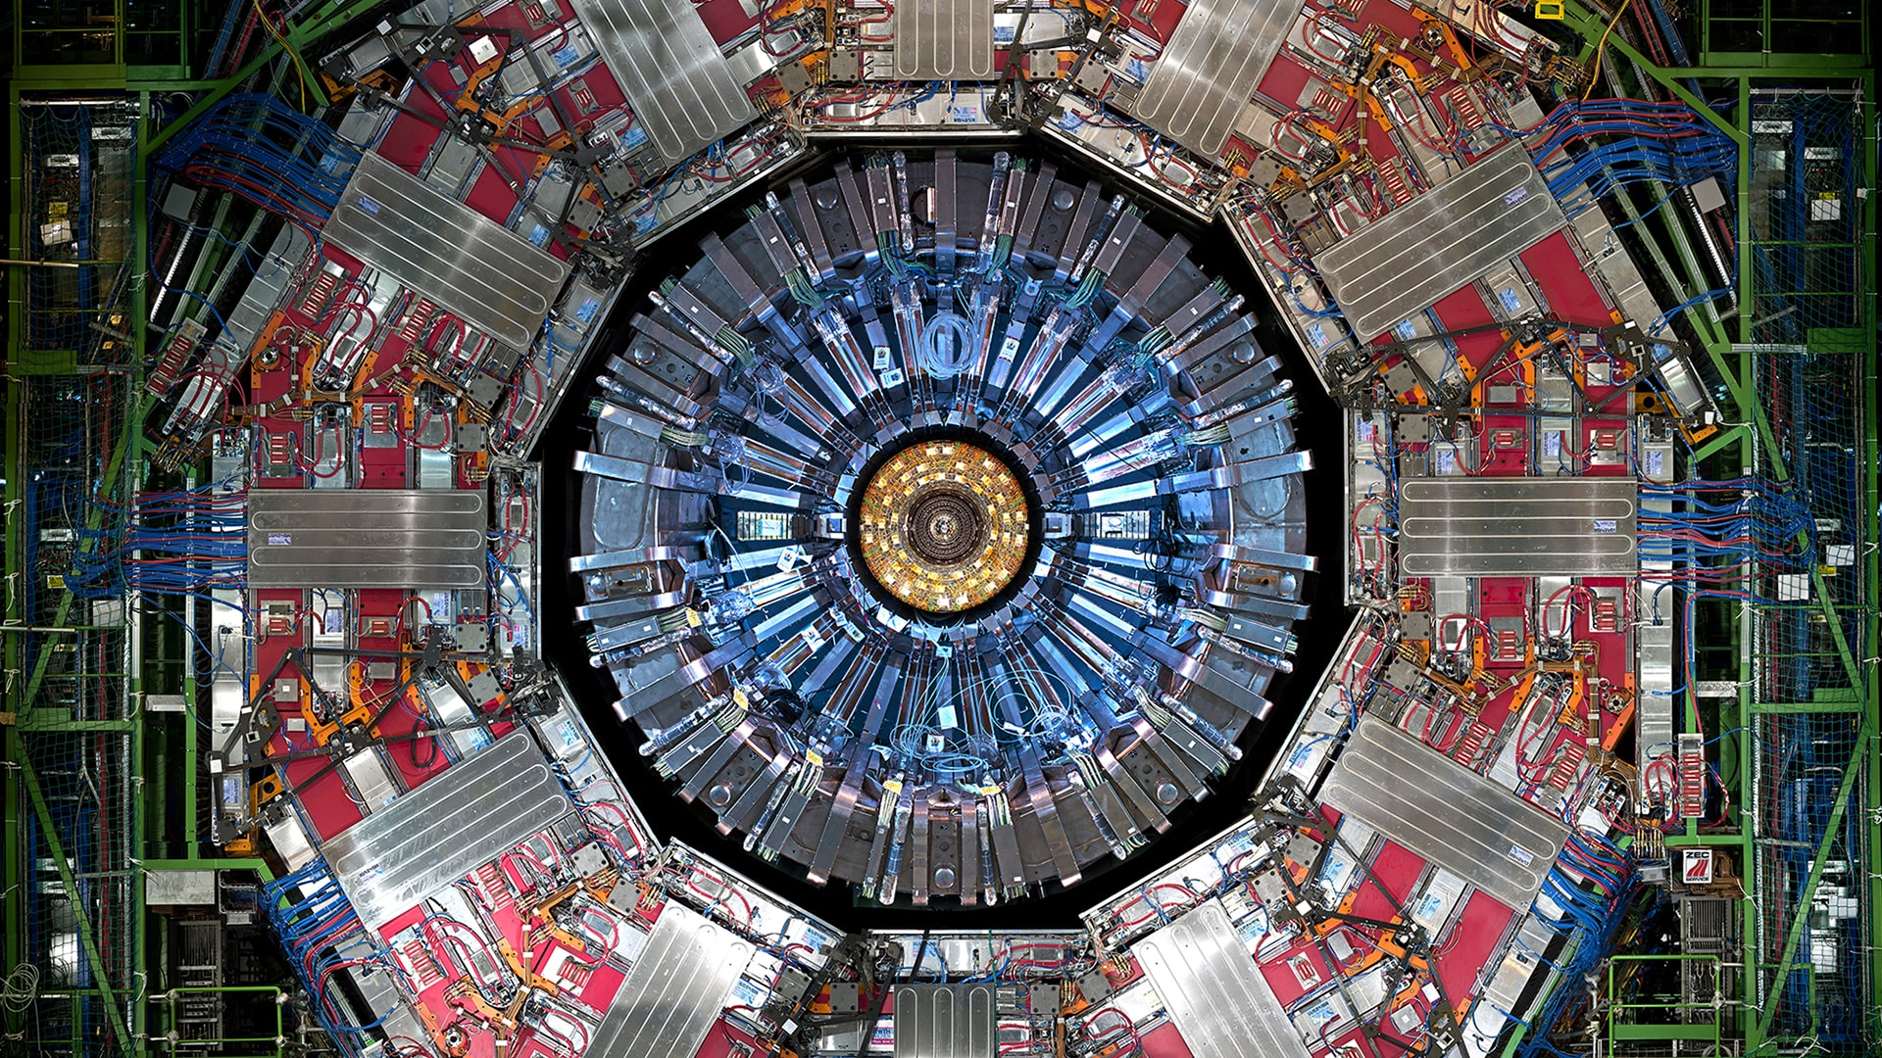
Dark Matter at CMS detector
Collider Search
DM
SM
DM
SM
DM
DM
DM does not leave it’s foot print to the CMS detector.

Slide 9
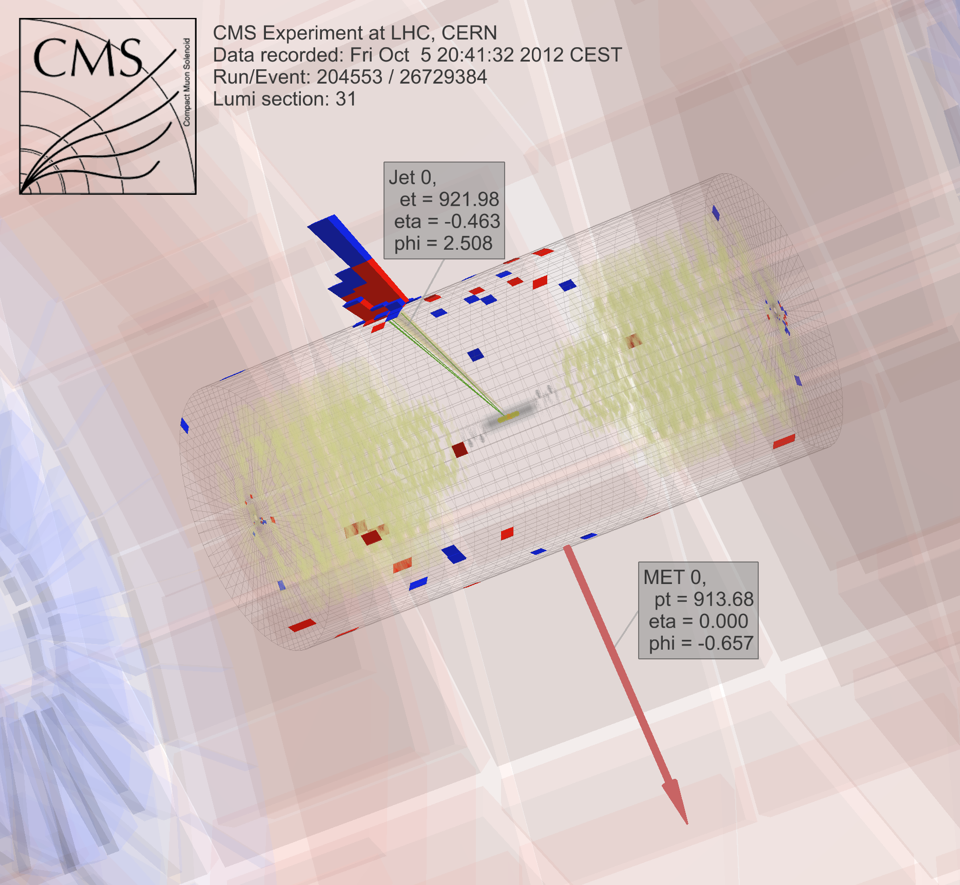
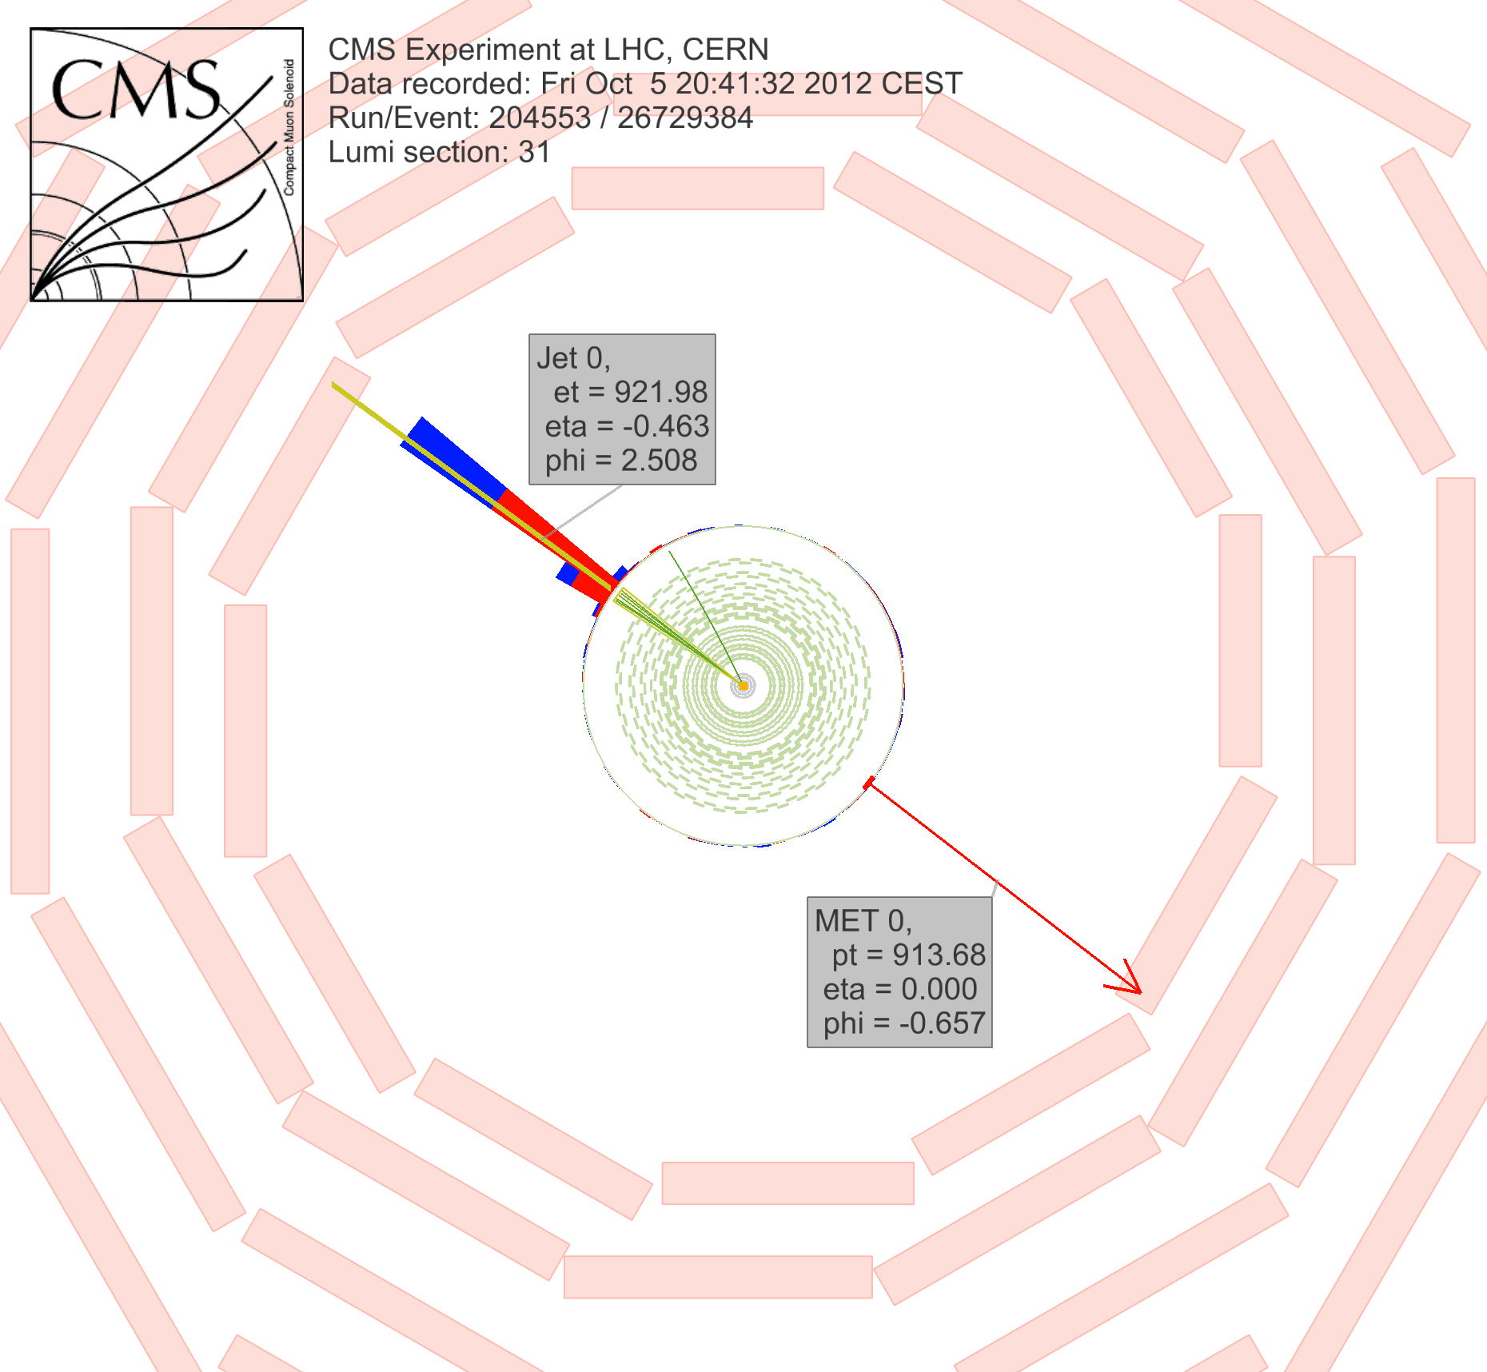
MET: Signature of Dark Matter
Collider Search
SM
SM
DM
ISR
SM
DM
Missing Transverse Momentum(MET)
https://twiki.cern.ch/twiki/bin/view/CMSPublic/PhysicsResultsEXO12048

Slide 10
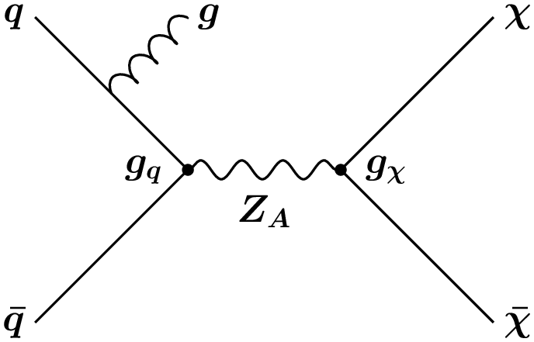
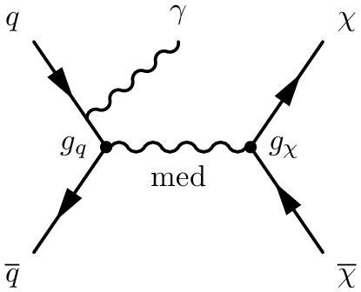
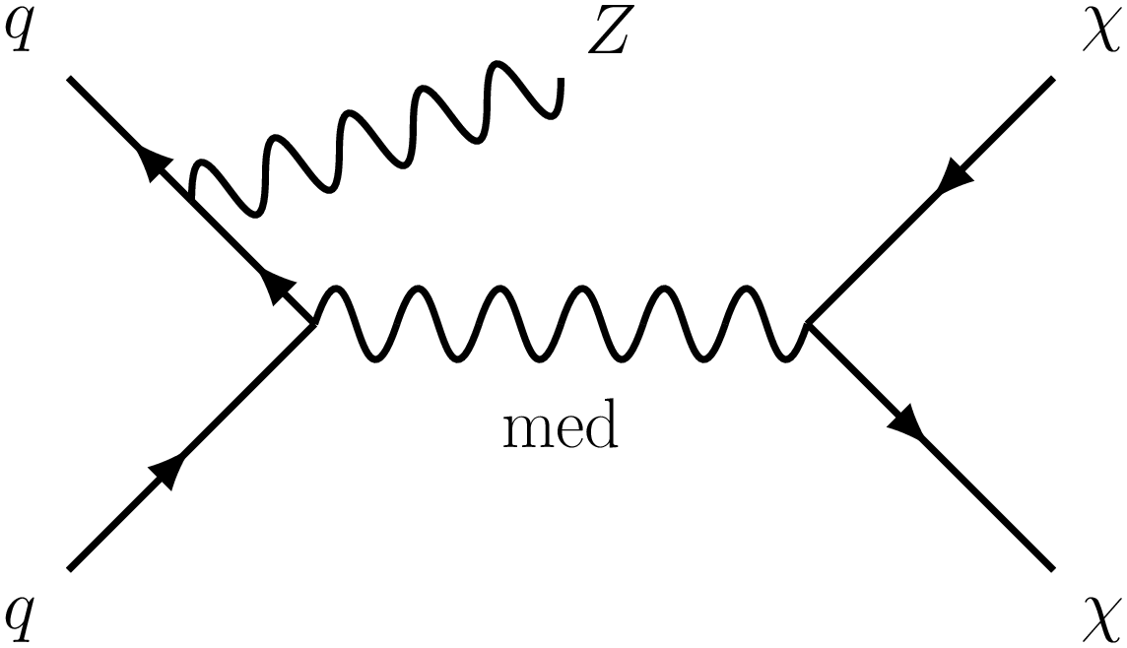
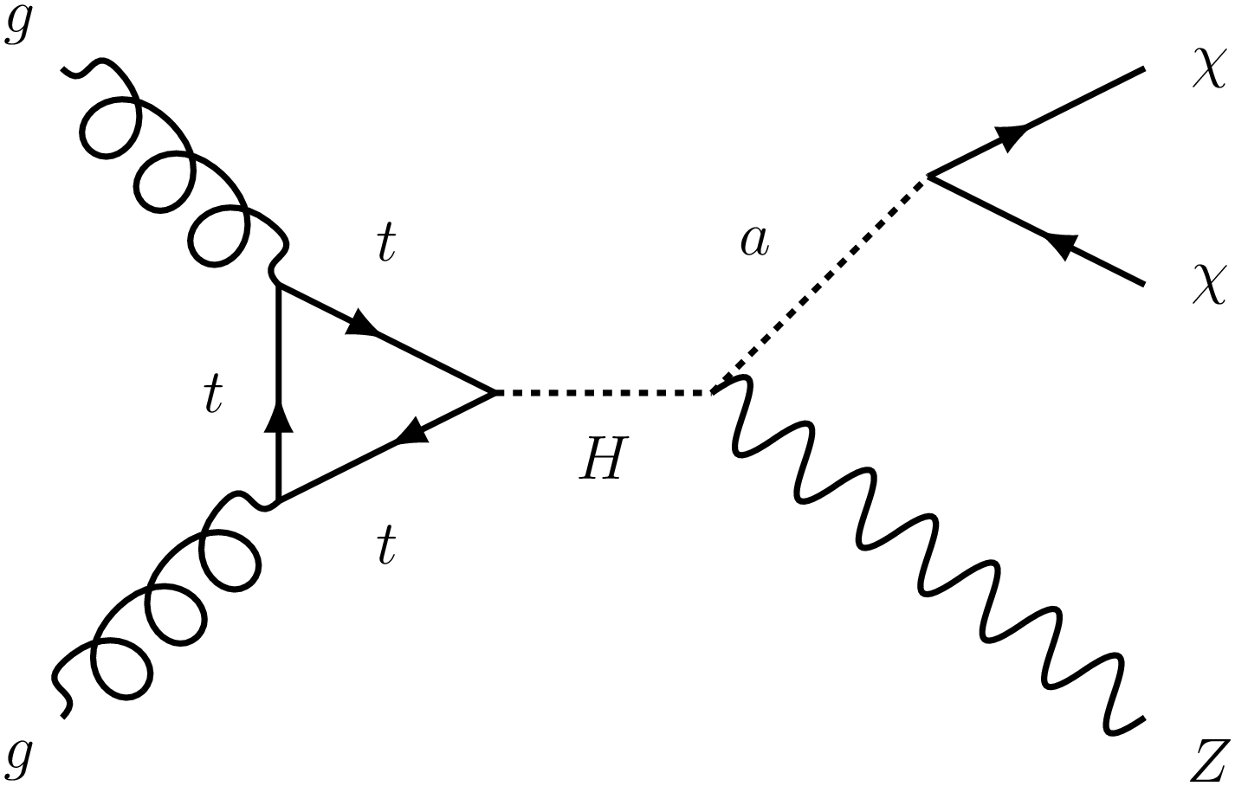
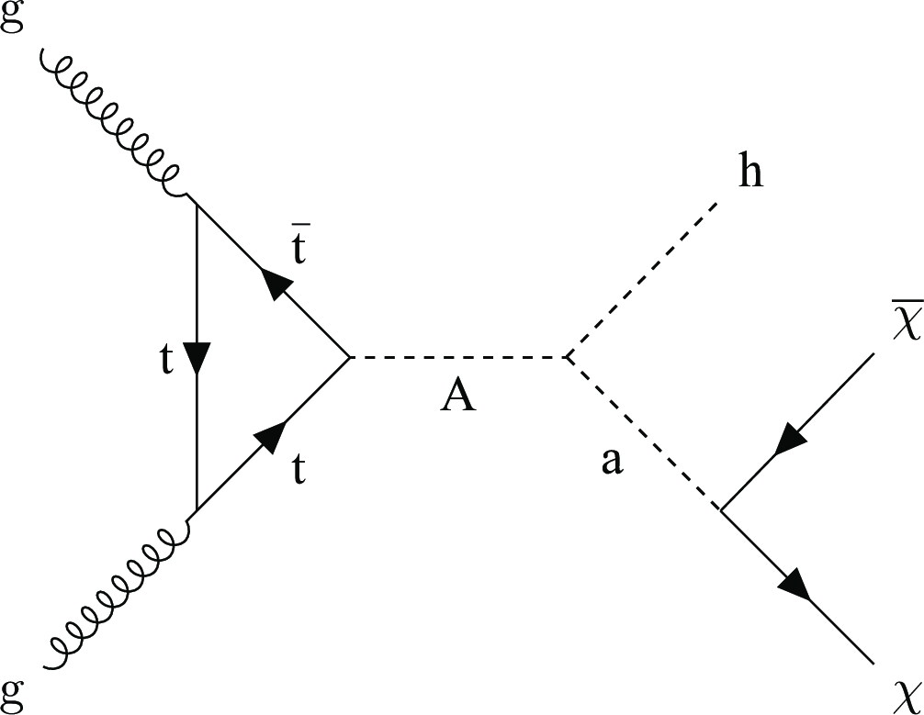
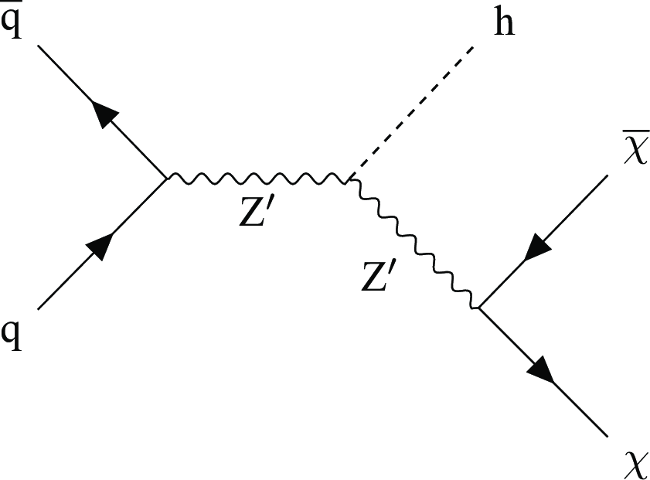
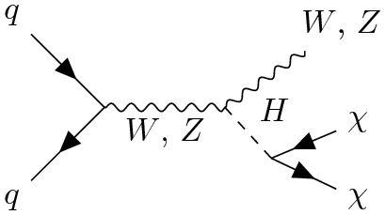
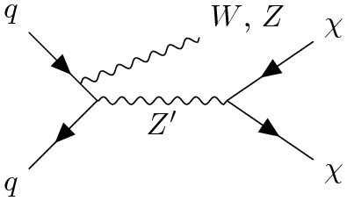
Dark Matter Signals
Mono Jet
Mono Photon
Mono Z
Mono H
Mono V(W/Z)
and many more ……

Slide 11
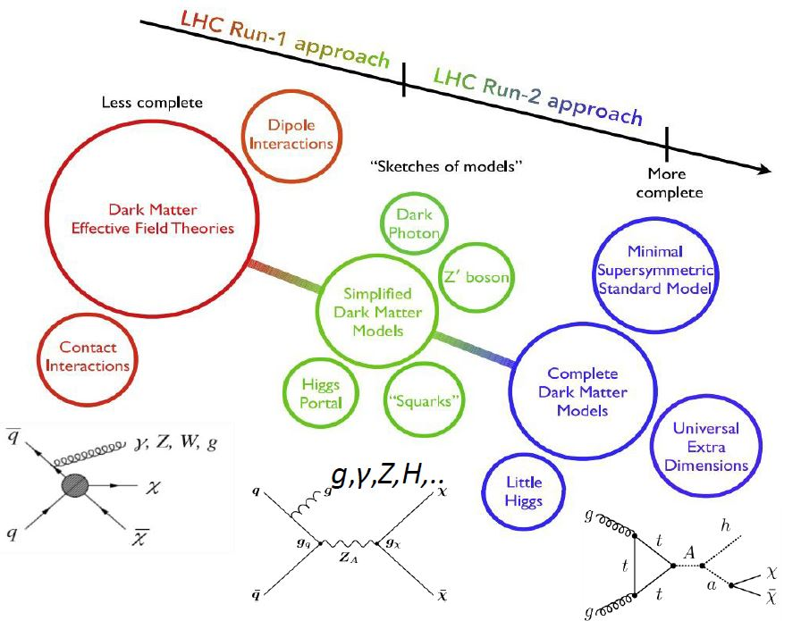
Dark Matter Models
J. Abdallah et al. / Physics of the Dark Universe 9–10 (2015) 8–23

Slide 12
The LHC Dark Matter Working Group
Guidelines and recommendations for benchmark models
LHC vs Direct/Indirect detection
Dark Matter limit for mediator searches
Dark Matter Simplified Model
Vector/axial vector or scalar/pseudo scalar mediator that couples to quarks and fermionic DM

Slide 13
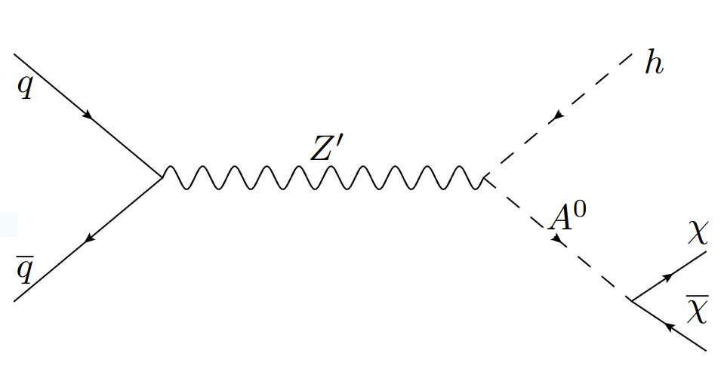
Mono Higgs + MET
Interpretation: 2HDM+a
2HDM model extended by an additional light pseudoscalar boson ‘a’
New pseudoscalar ‘a’ which mediates the interactions between the SM and DM
Simplest renormalisable and gauge-invariant
Interpretation: Z’-2HDM
2HDM model extended by a U(1)_{Z’} group
Vector Z’ produced resonantly, decays into SM-like h and heavy pseudoscalar A⁰ that couples to DM
Interpretation: Z’-Baryonic
New U(1)_{B} symmetry → Z’ boson
Symmetry broken by heavy Higgs field with boson H_{B} that mixes with SM Higgs boson
Z’ acts as a DM mediator and can radiate a Higgs boson

Slide 14
Mono Higgs ($→γγ$) + MET
Event Selection
Trigger: Diphoton trigger with loose p_{T} threshold and a very loose selection criteria based on cluster shower shape, isolation, ratio of hadronic to electromagnetic energy deposits imposed on both photon candidates. Diphoton invariant mass > 90 GeV.
Pass Photon Identification Criteria
Kinematic Selection:
High MET Category:
MET ($p_{T}^{miss})>130 GeV$
$p_{T}^{γ1}>0.5 m_{γγ}$
$p_{T}^{γ2}>0.25 m_{γγ}$
$p_{T}^{γγ}>90 GeV$
No of jets < 3 ($p_{T}^{jet}>30 GeV$) (suppress the contribution from the QCD background)
Topological cuts
min|Δφ(jet, MET)| > 0.5 (to avoid any high energetic jet collinear to the MET)
|Δφ(γγ, MET)| > 2.1 (to select events where the Higgs boson and the MET are back-to-back)
Low-MET Category:
MET ($p_{T}^{miss})>in [50,130] GeV$
$p_{T}^{γ1}>0.45 m_{γγ}$
$p_{T}^{γ2}>0.25 m_{γγ}$
$p_{T}^{γγ}>75 GeV$

Slide 15
Mono Higgs ($→γγ$) + MET
Background
Irreducible background
Associate production of Higgs boson and a Z boson where Z decays to two neutrinos
Reducible backgrounds
Resonant
The SM Higgs production (VBF,ttH) decaying to two photons with mismeasured MET
The SM Higgs production in association with a W boson where W goes to lepton and neutrino
Non-Resonant
QCD, γγ, γ + jet, and Drell-Yan production in association with jets with the Z boson decaying to electron pairs and neutrinos
Z, ZZ, t, $t\overline{t}$ or W boson + 1 or 2 photons,

Slide 16
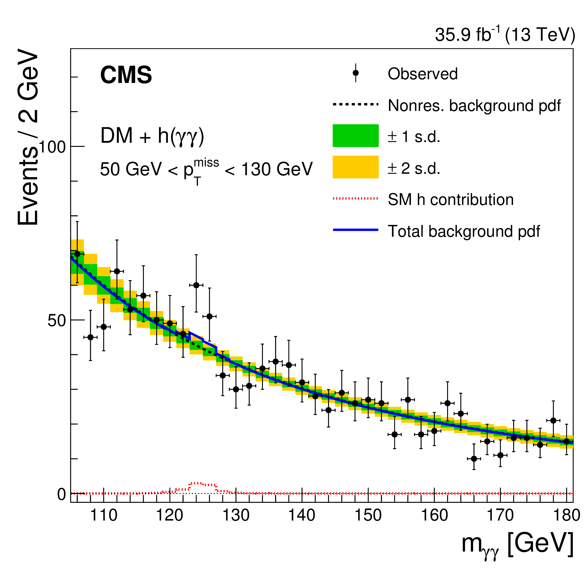
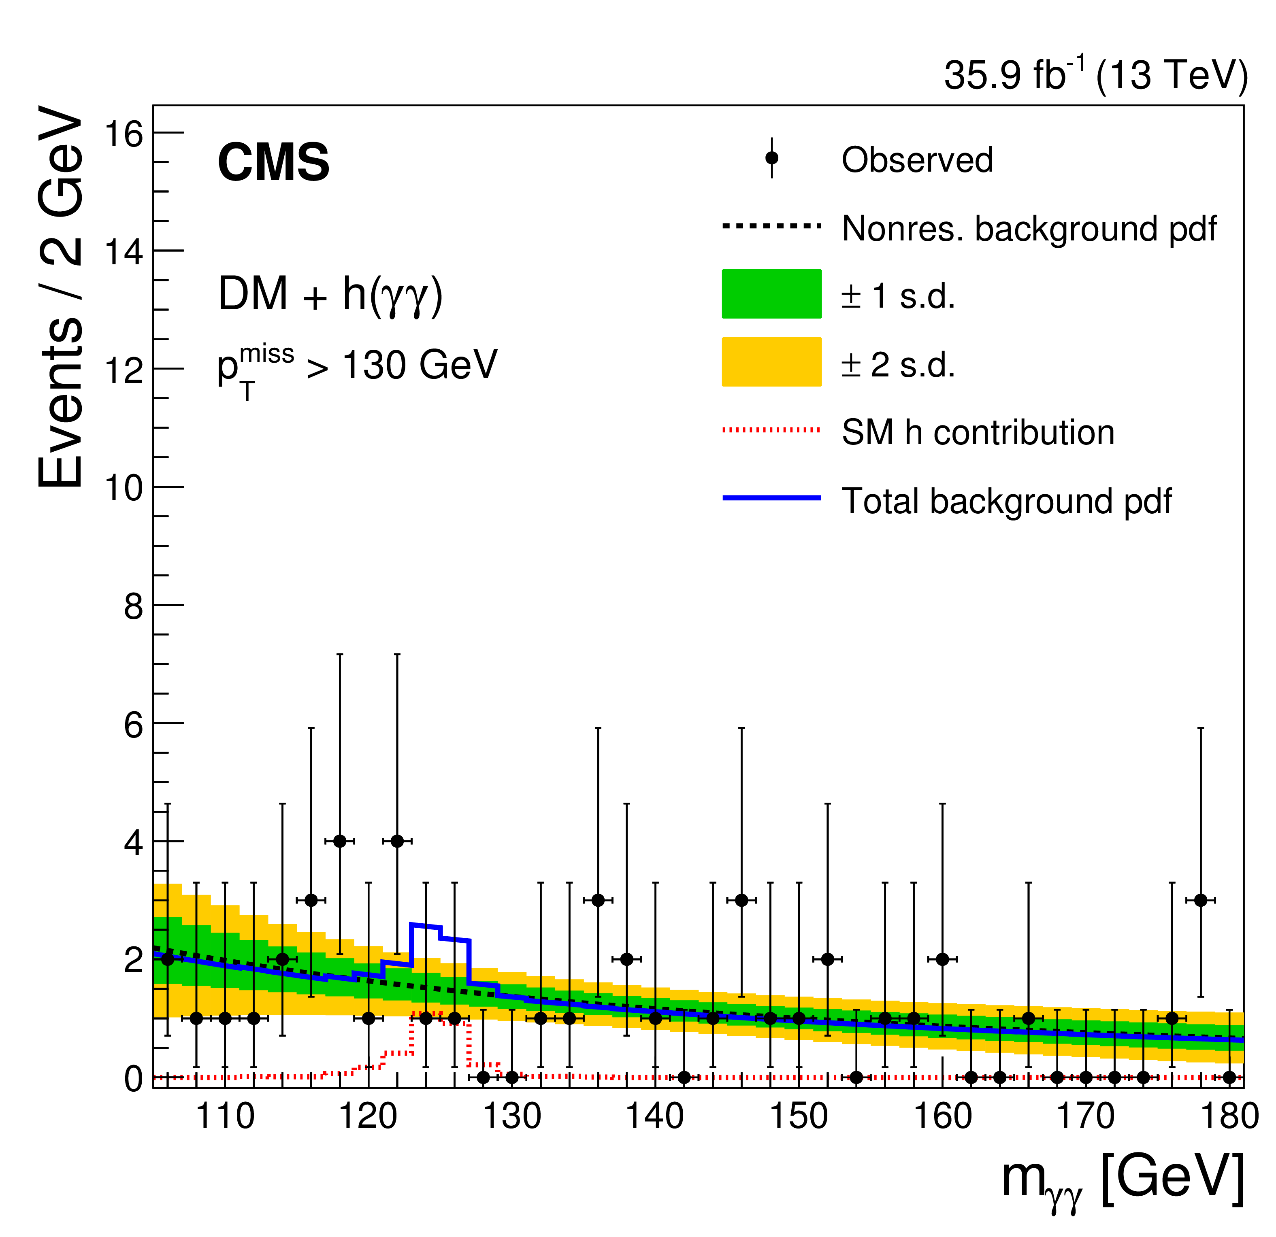
Mono Higgs ($→γγ$) + MET
Background Estimation
Data driven techniques used to estimate non-resonant backgrounds
Background Model from data: fitted non-resonant diphoton m_{γγ} distribution, in both MET categories (Blinded in m_{γγ} [115,135] GeV )
Best fit function: power law function $f\left(x\right)=ax^{−b}$
Resonant background shape form MC template
Background only fit simultaneously the diphoton m_{γγ} distribution in each MET category

Slide 17
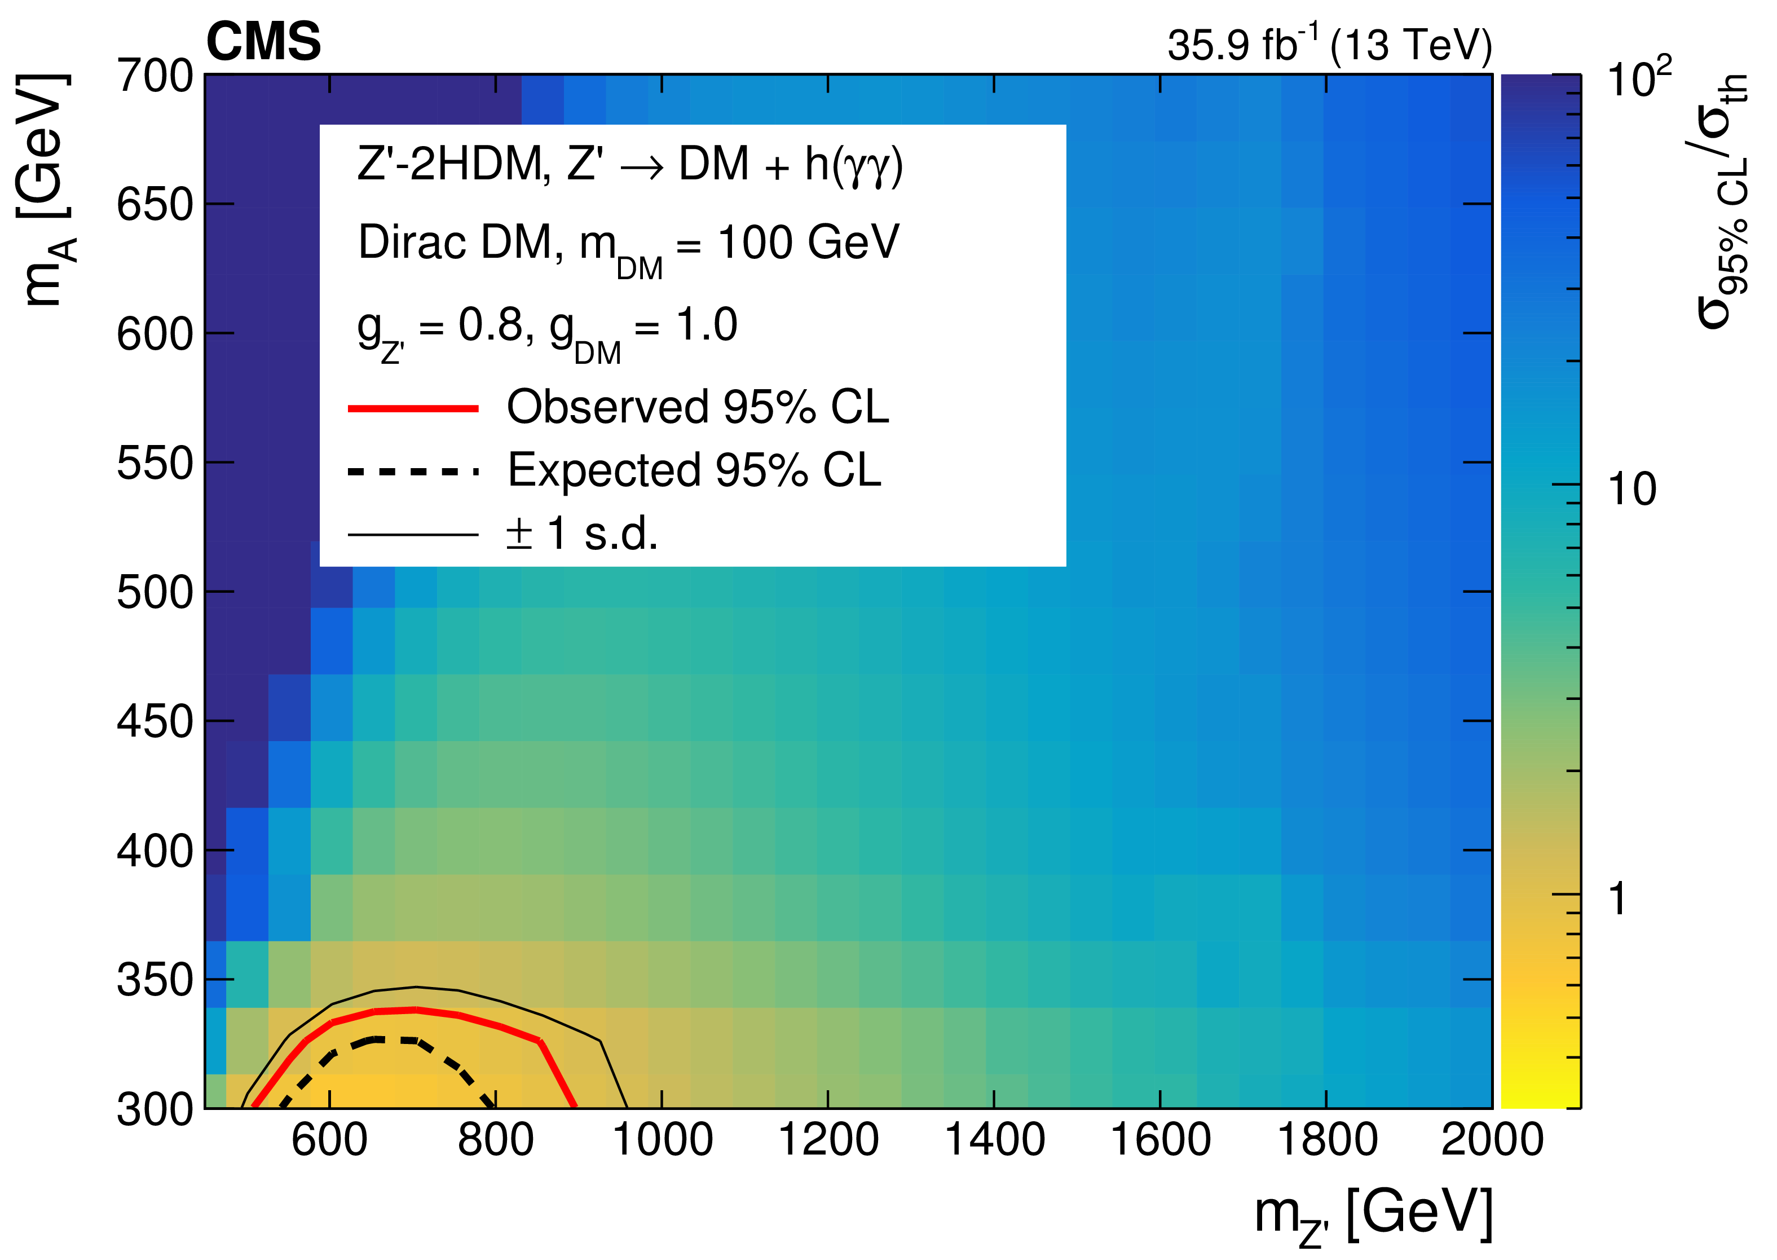
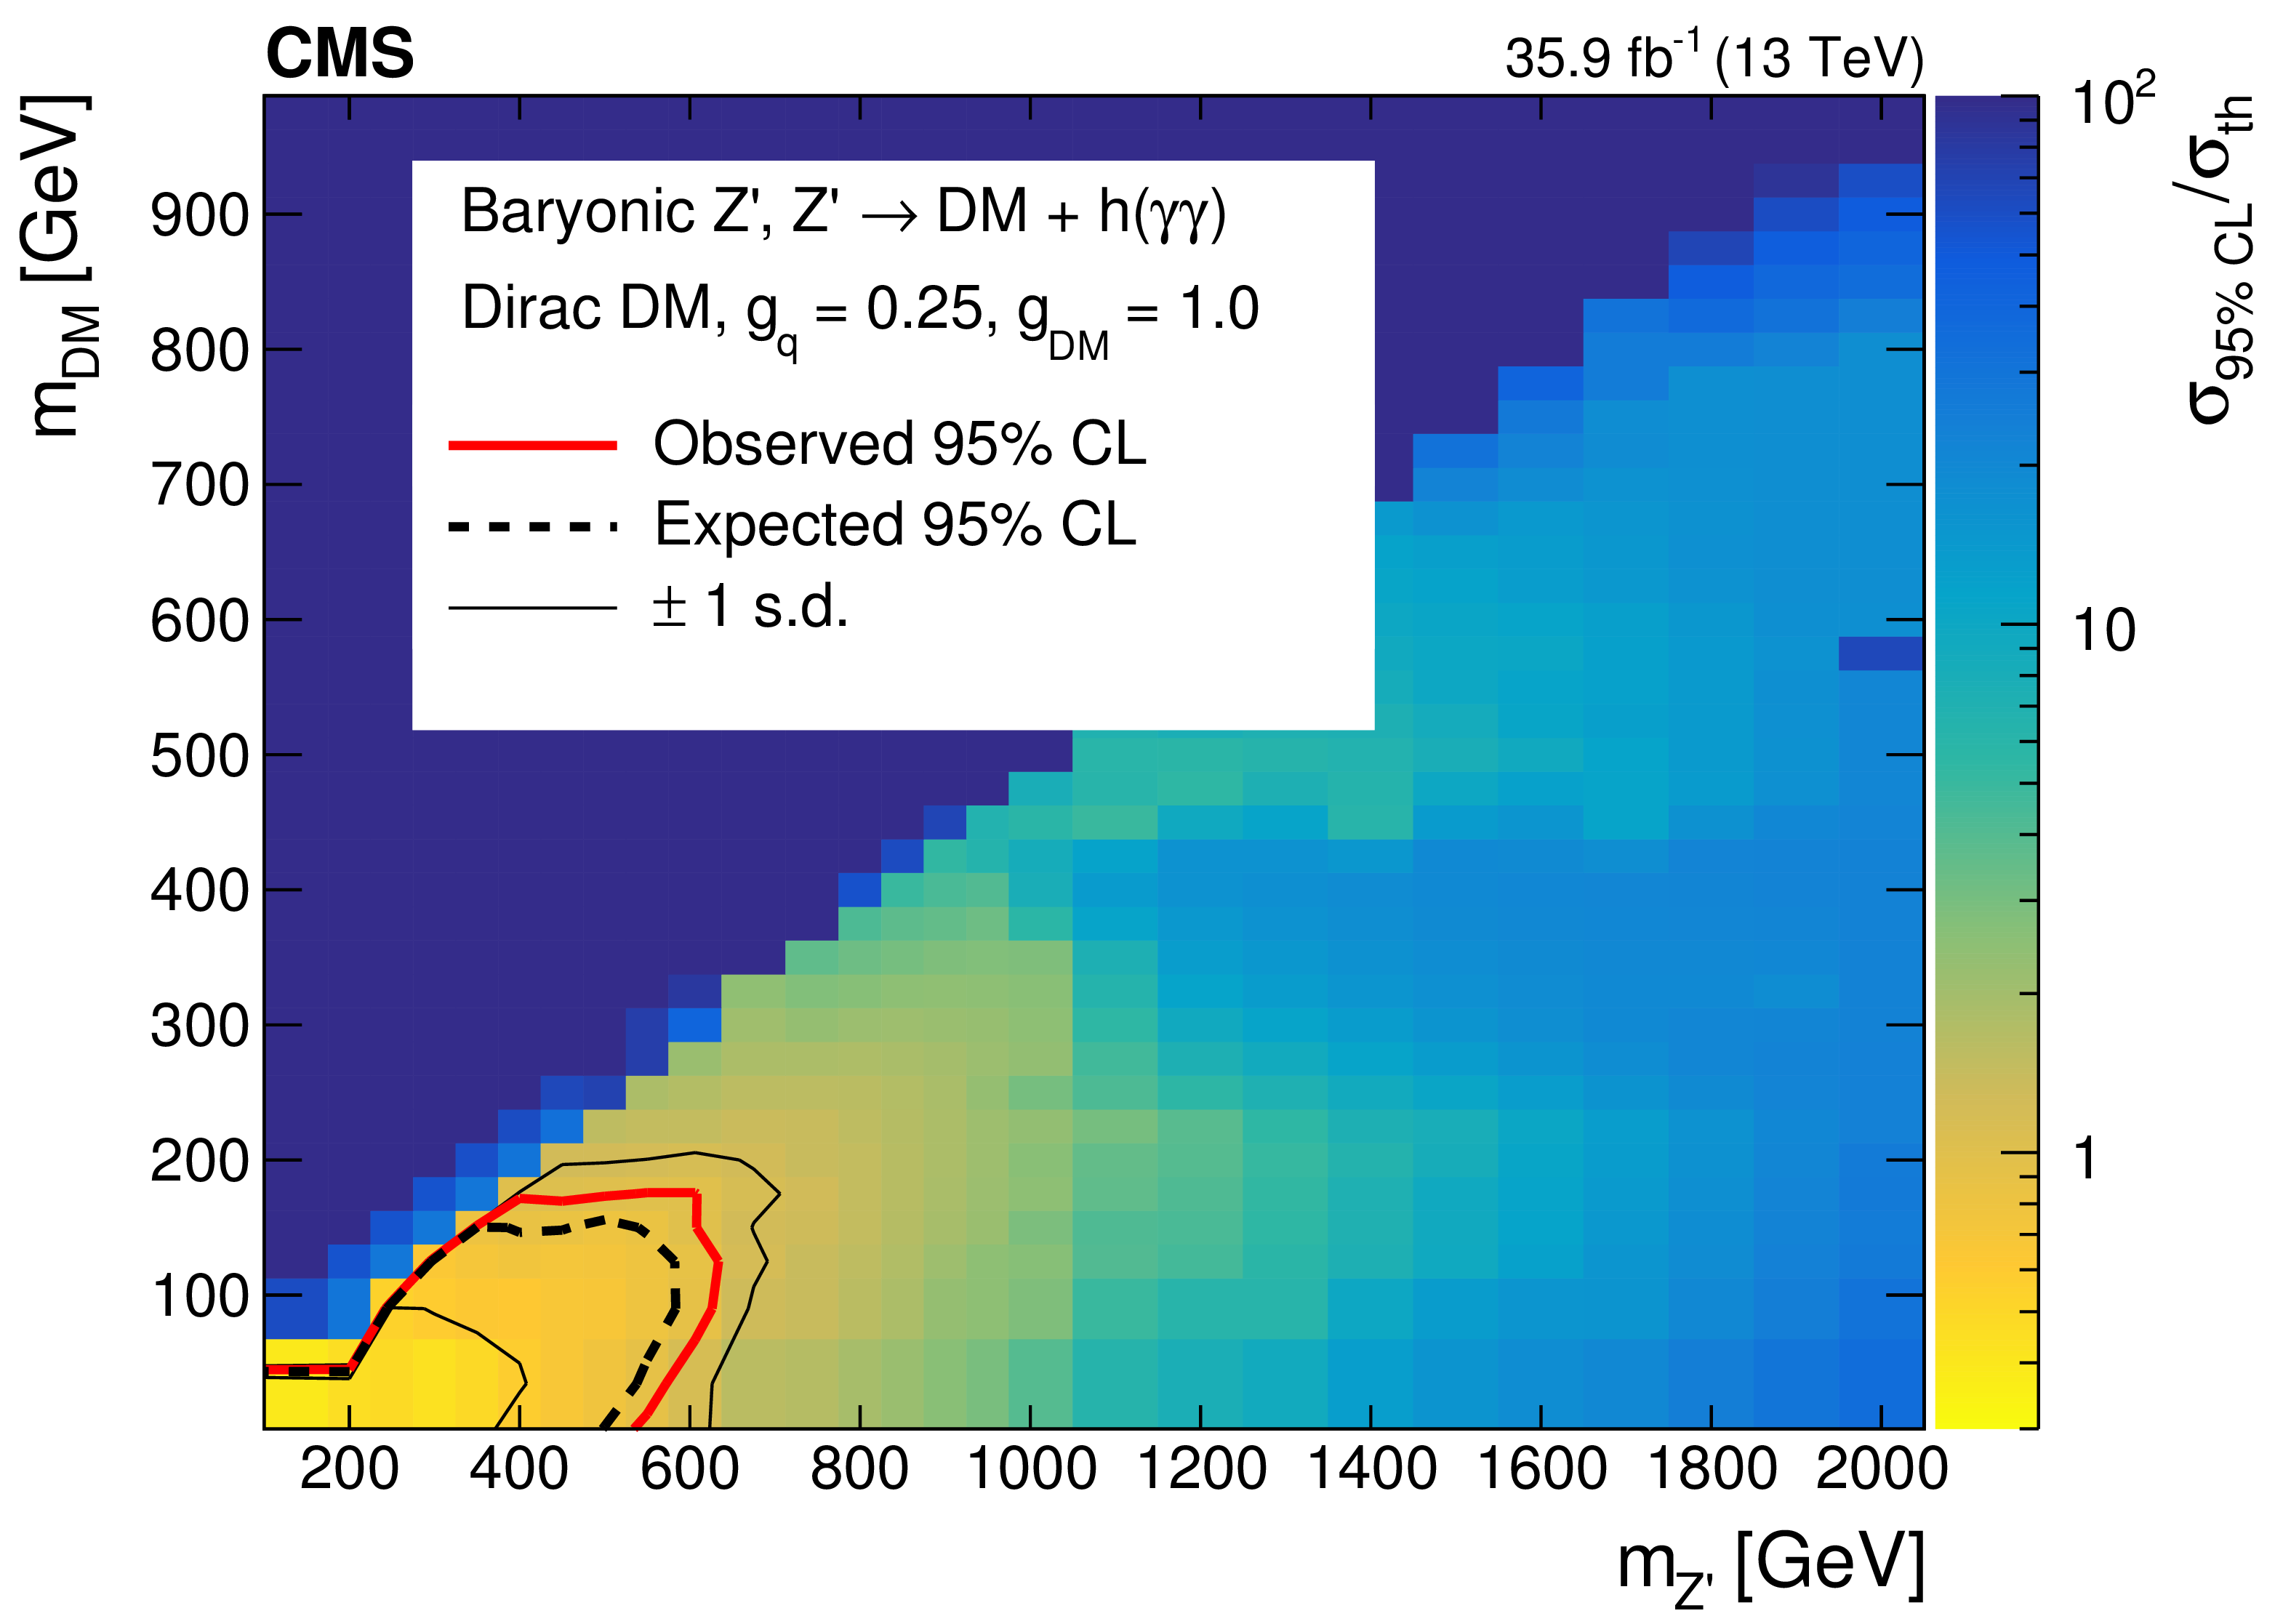
Mono Higgs ($→γγ$) + MET (35.9 fb⁻¹)
Results
Interpretation: Z’-2HDM
Interpretation: Z’-Baryonic
JHEP09 (2018) 046

Slide 18
Mono Higgs ($→bb$) + MET
Event Selection
Event Selection
Exactly one CA15 fat jet (Cluster using the Cambridge-Aachen algorithm with R = 1:5, double b tagger)
p_{T} > 200 GeV and |$ɳ$| < 2.4
soft-drop mass within 100 - 150 GeV (required to be consistent with the Higgs boson mass)
modified tagging variable N^{DDT}₂ < 0 (discriminate from CA15 QCD, t jets)
MET($p_{T}^{miss})>200 GeV$
τ veto
Δφ(AK4 jets, MET) > 0.4

Slide 19
Mono Higgs ($→bb$) + MET
Background Estimation
Dominant background
$Z(→νν)$+jets
W+jets
$t\overline{t}$ production
Other backgrounds
Single top
Dibosons
SM h (VH)
Determine most important backgrounds from 6 control regions by introducing bin-by-bin transfer factors from shape of MET

Slide 20
Mono Higgs ($→bb$) + MET
Background Estimation
35.9 fb⁻¹ (13 TeV)
No excess in data over SM prediction

Slide 21
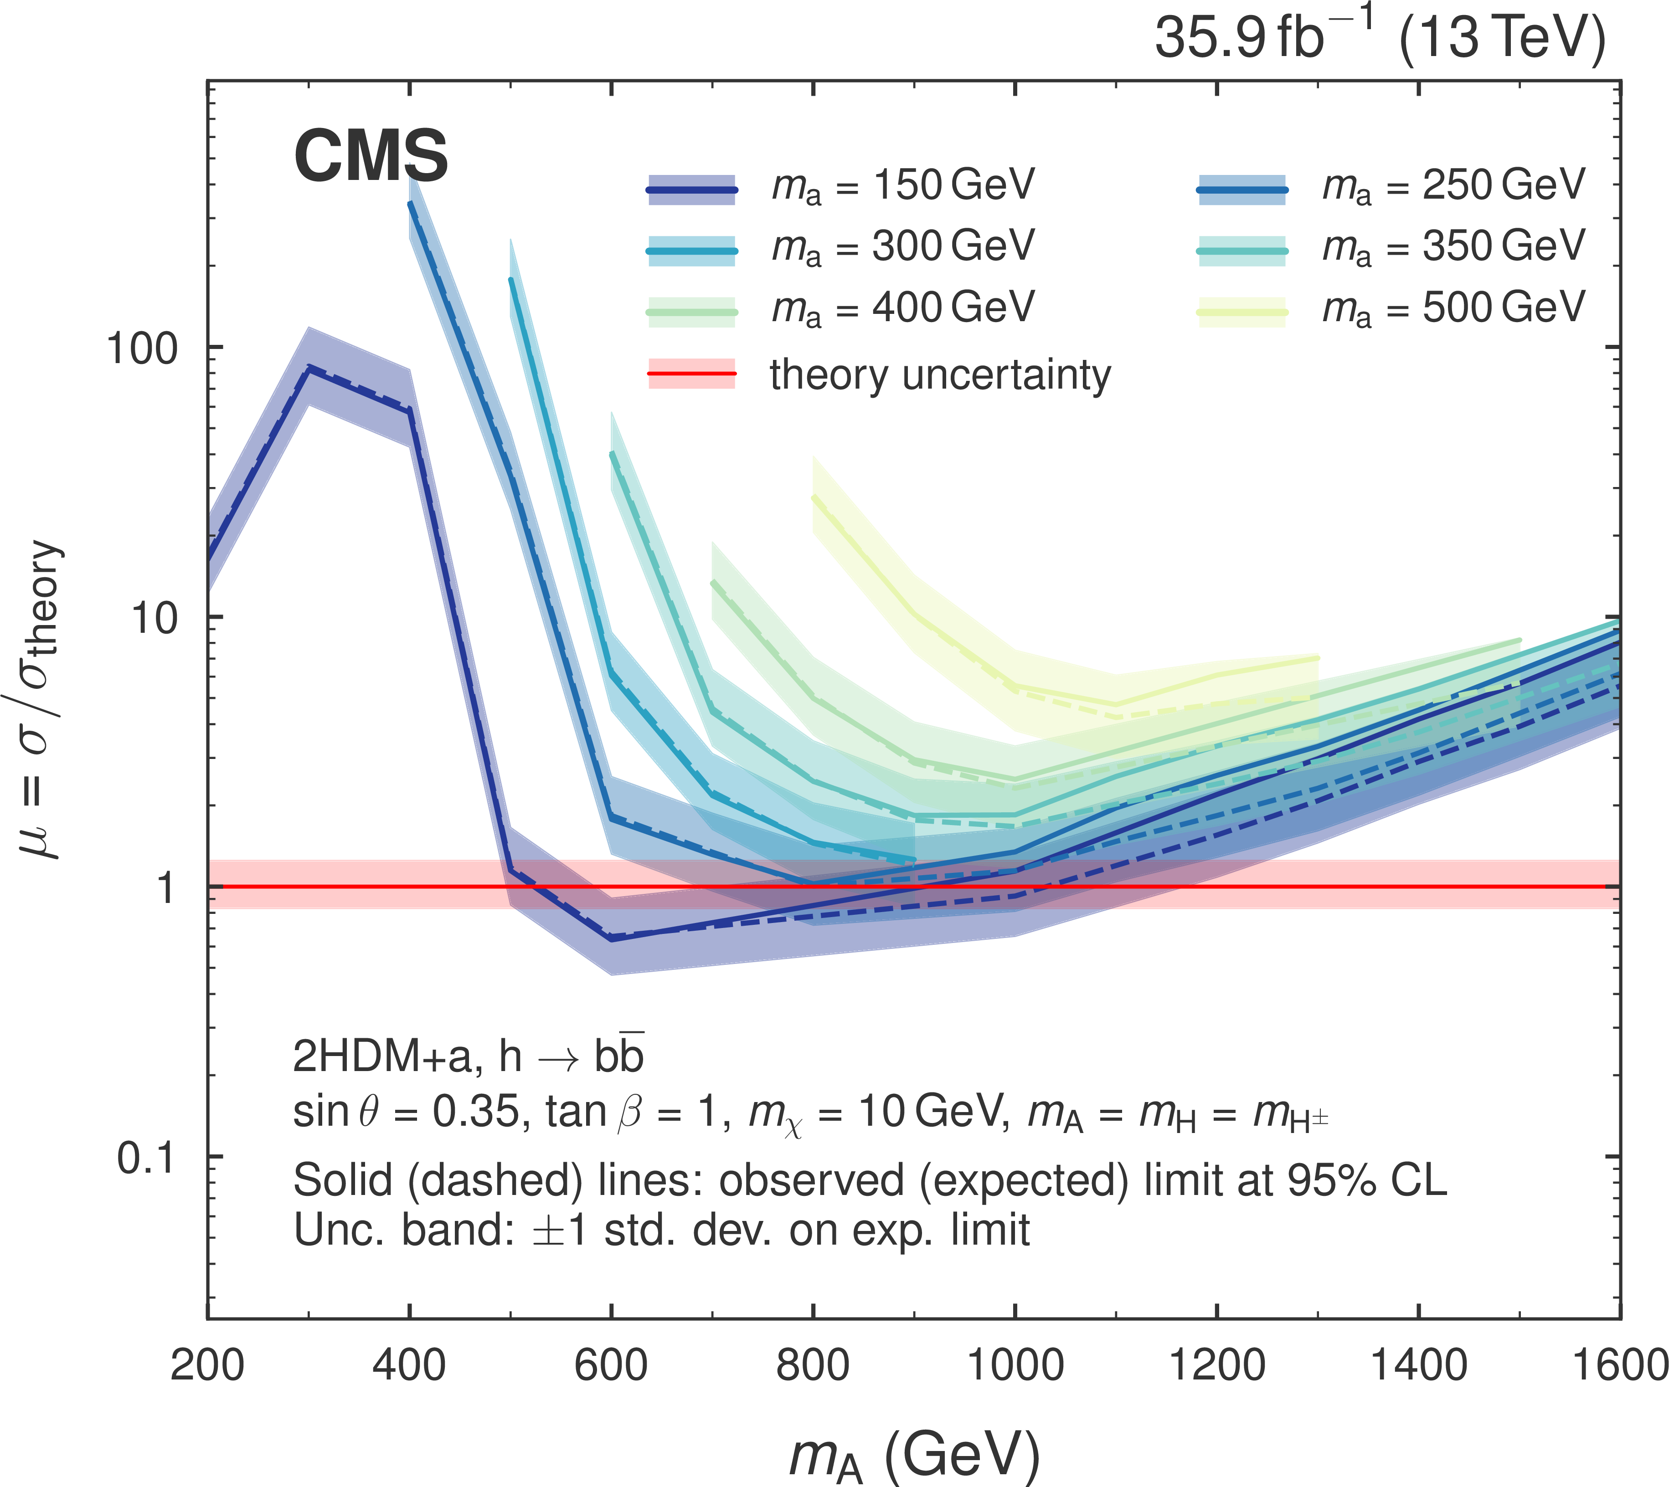
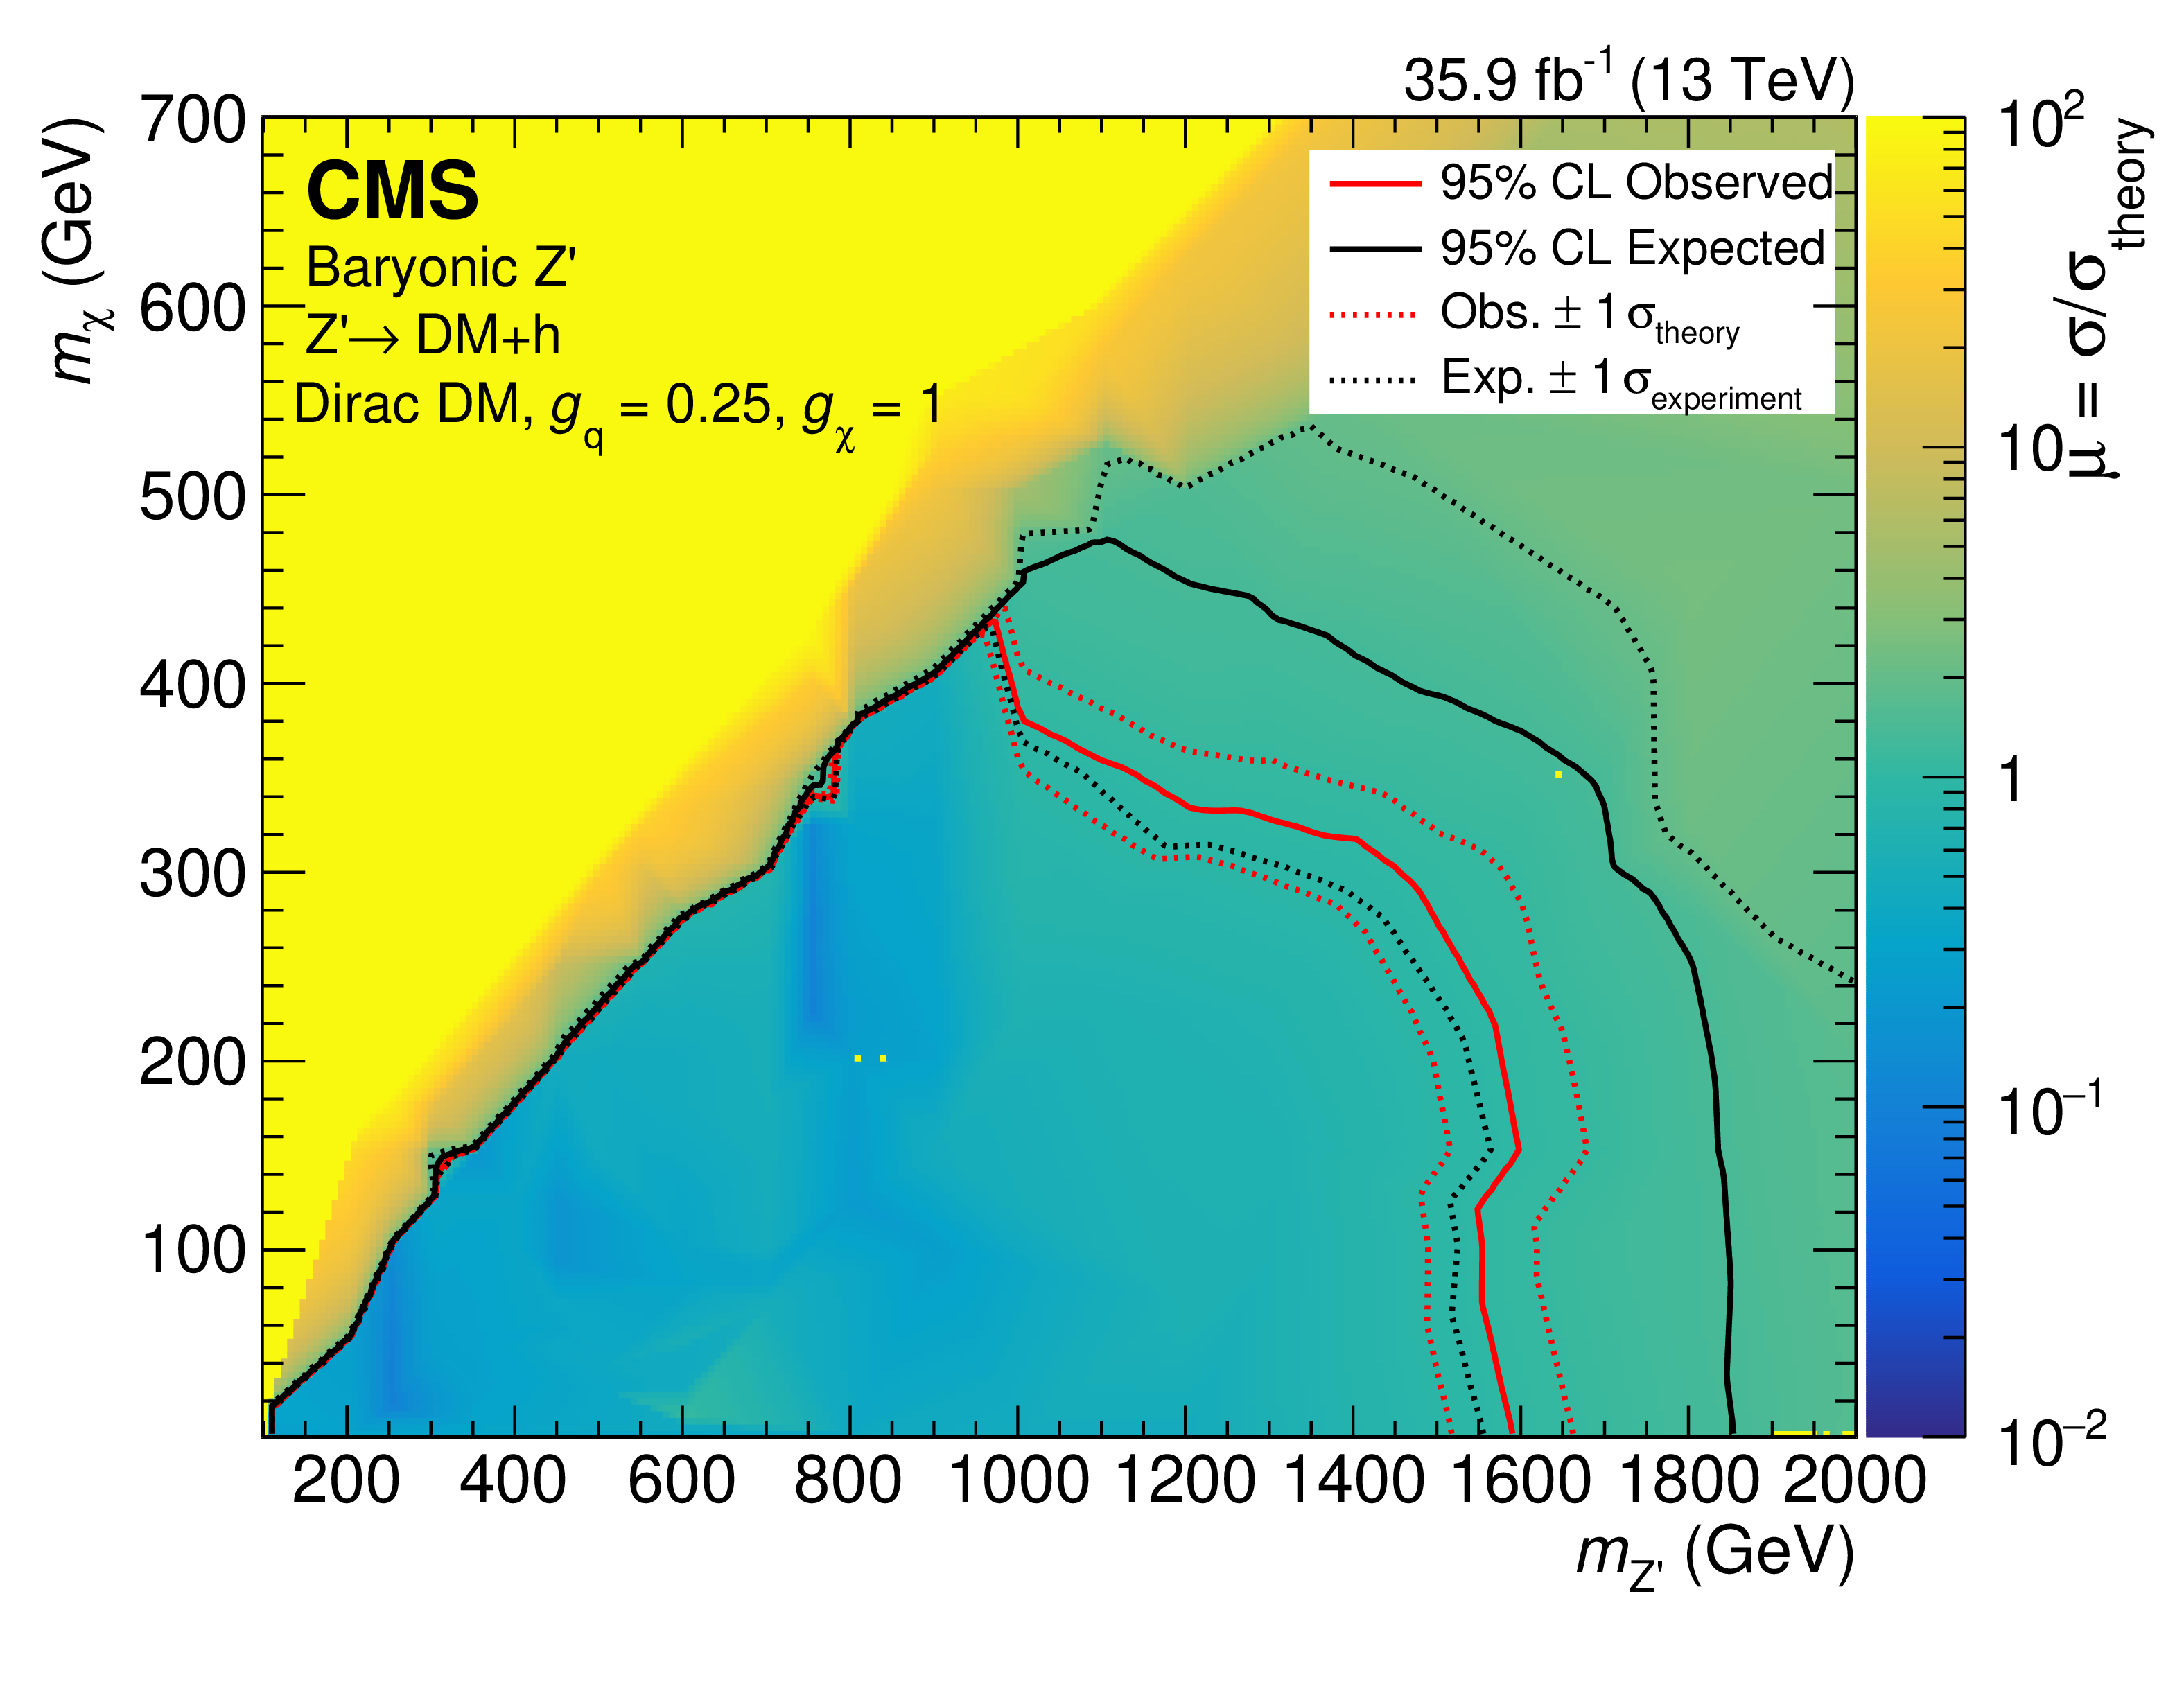
Mono Higgs ($→bb$) + MET (35.9 fb⁻¹)
Results
Interpretation: 2HDM+a
Interpretation: Z’-Baryonic
Eur. Phys. J. C (2019) 79:280

Slide 22
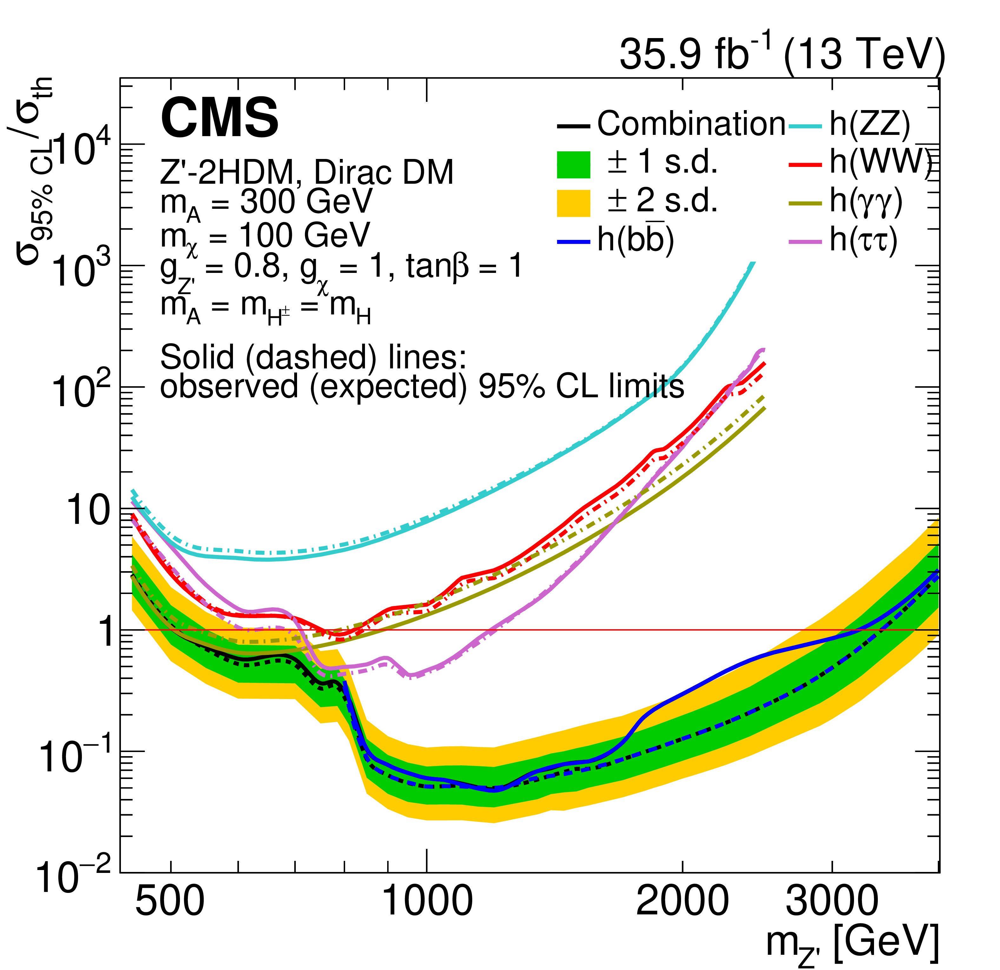
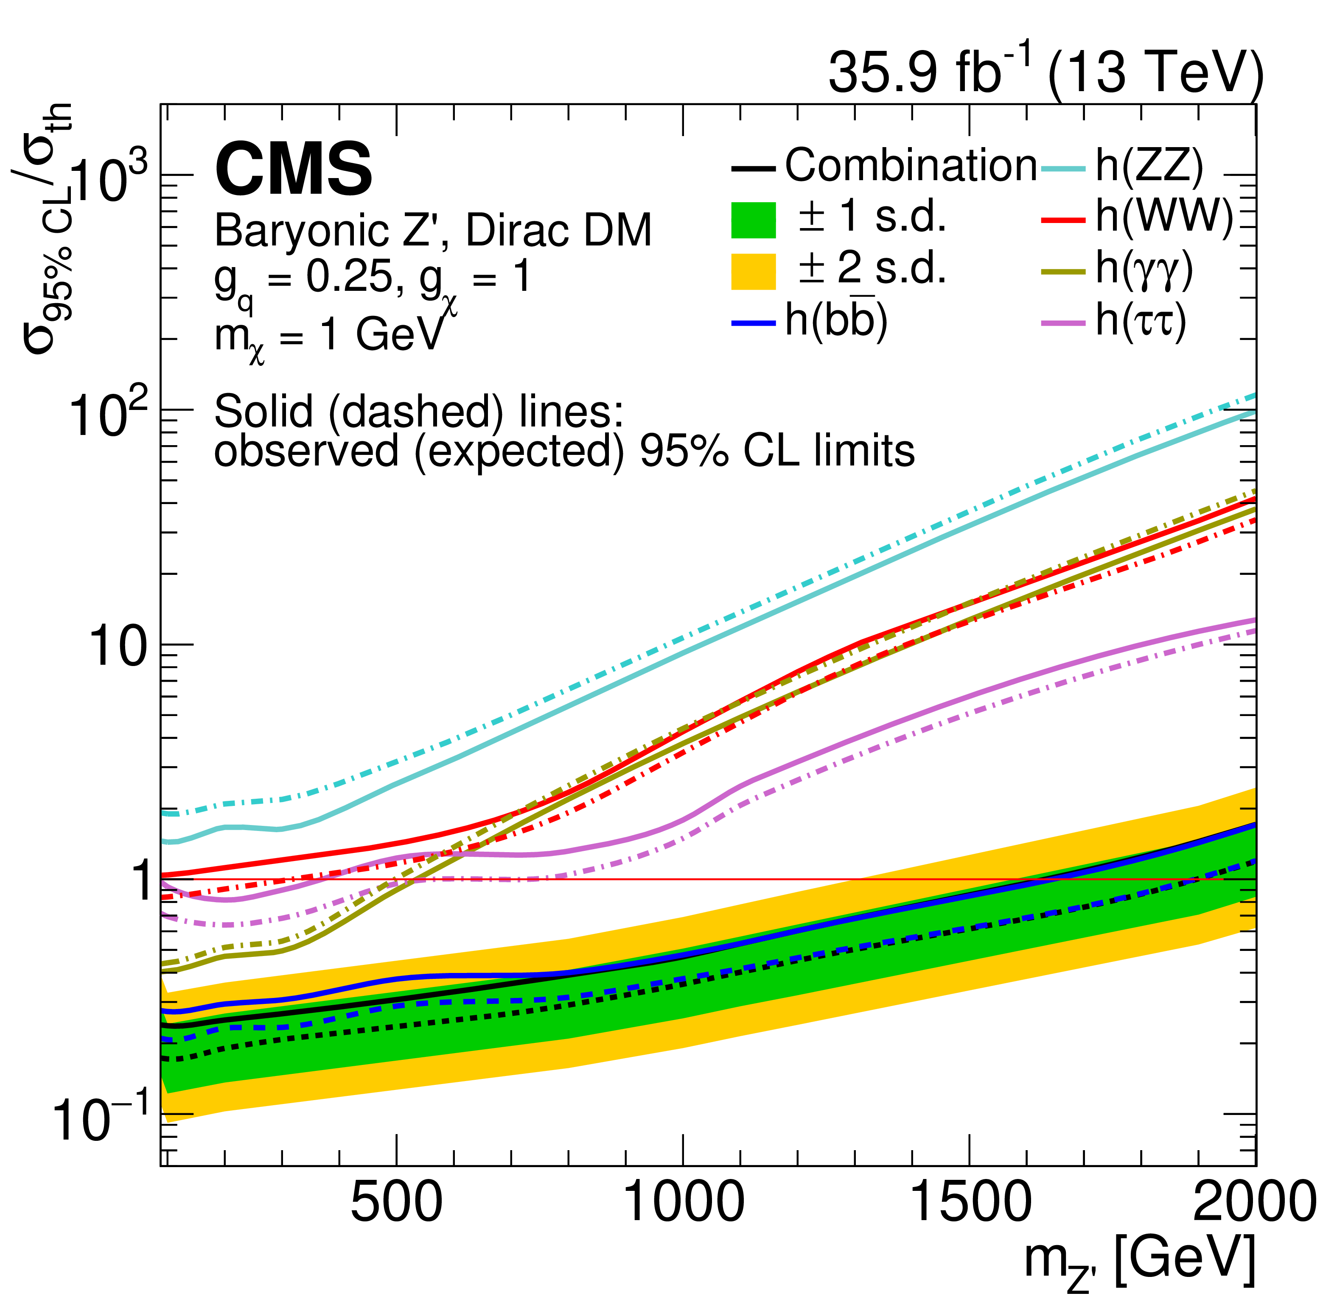
Mono Higgs ($→bb$, $γγ$,ττ, ZZ,WW) + MET
Results
Interpretation: Z’-2HDM
Interpretation: Z’-Baryonic
JHEP 2003 (2020) 025

Slide 23
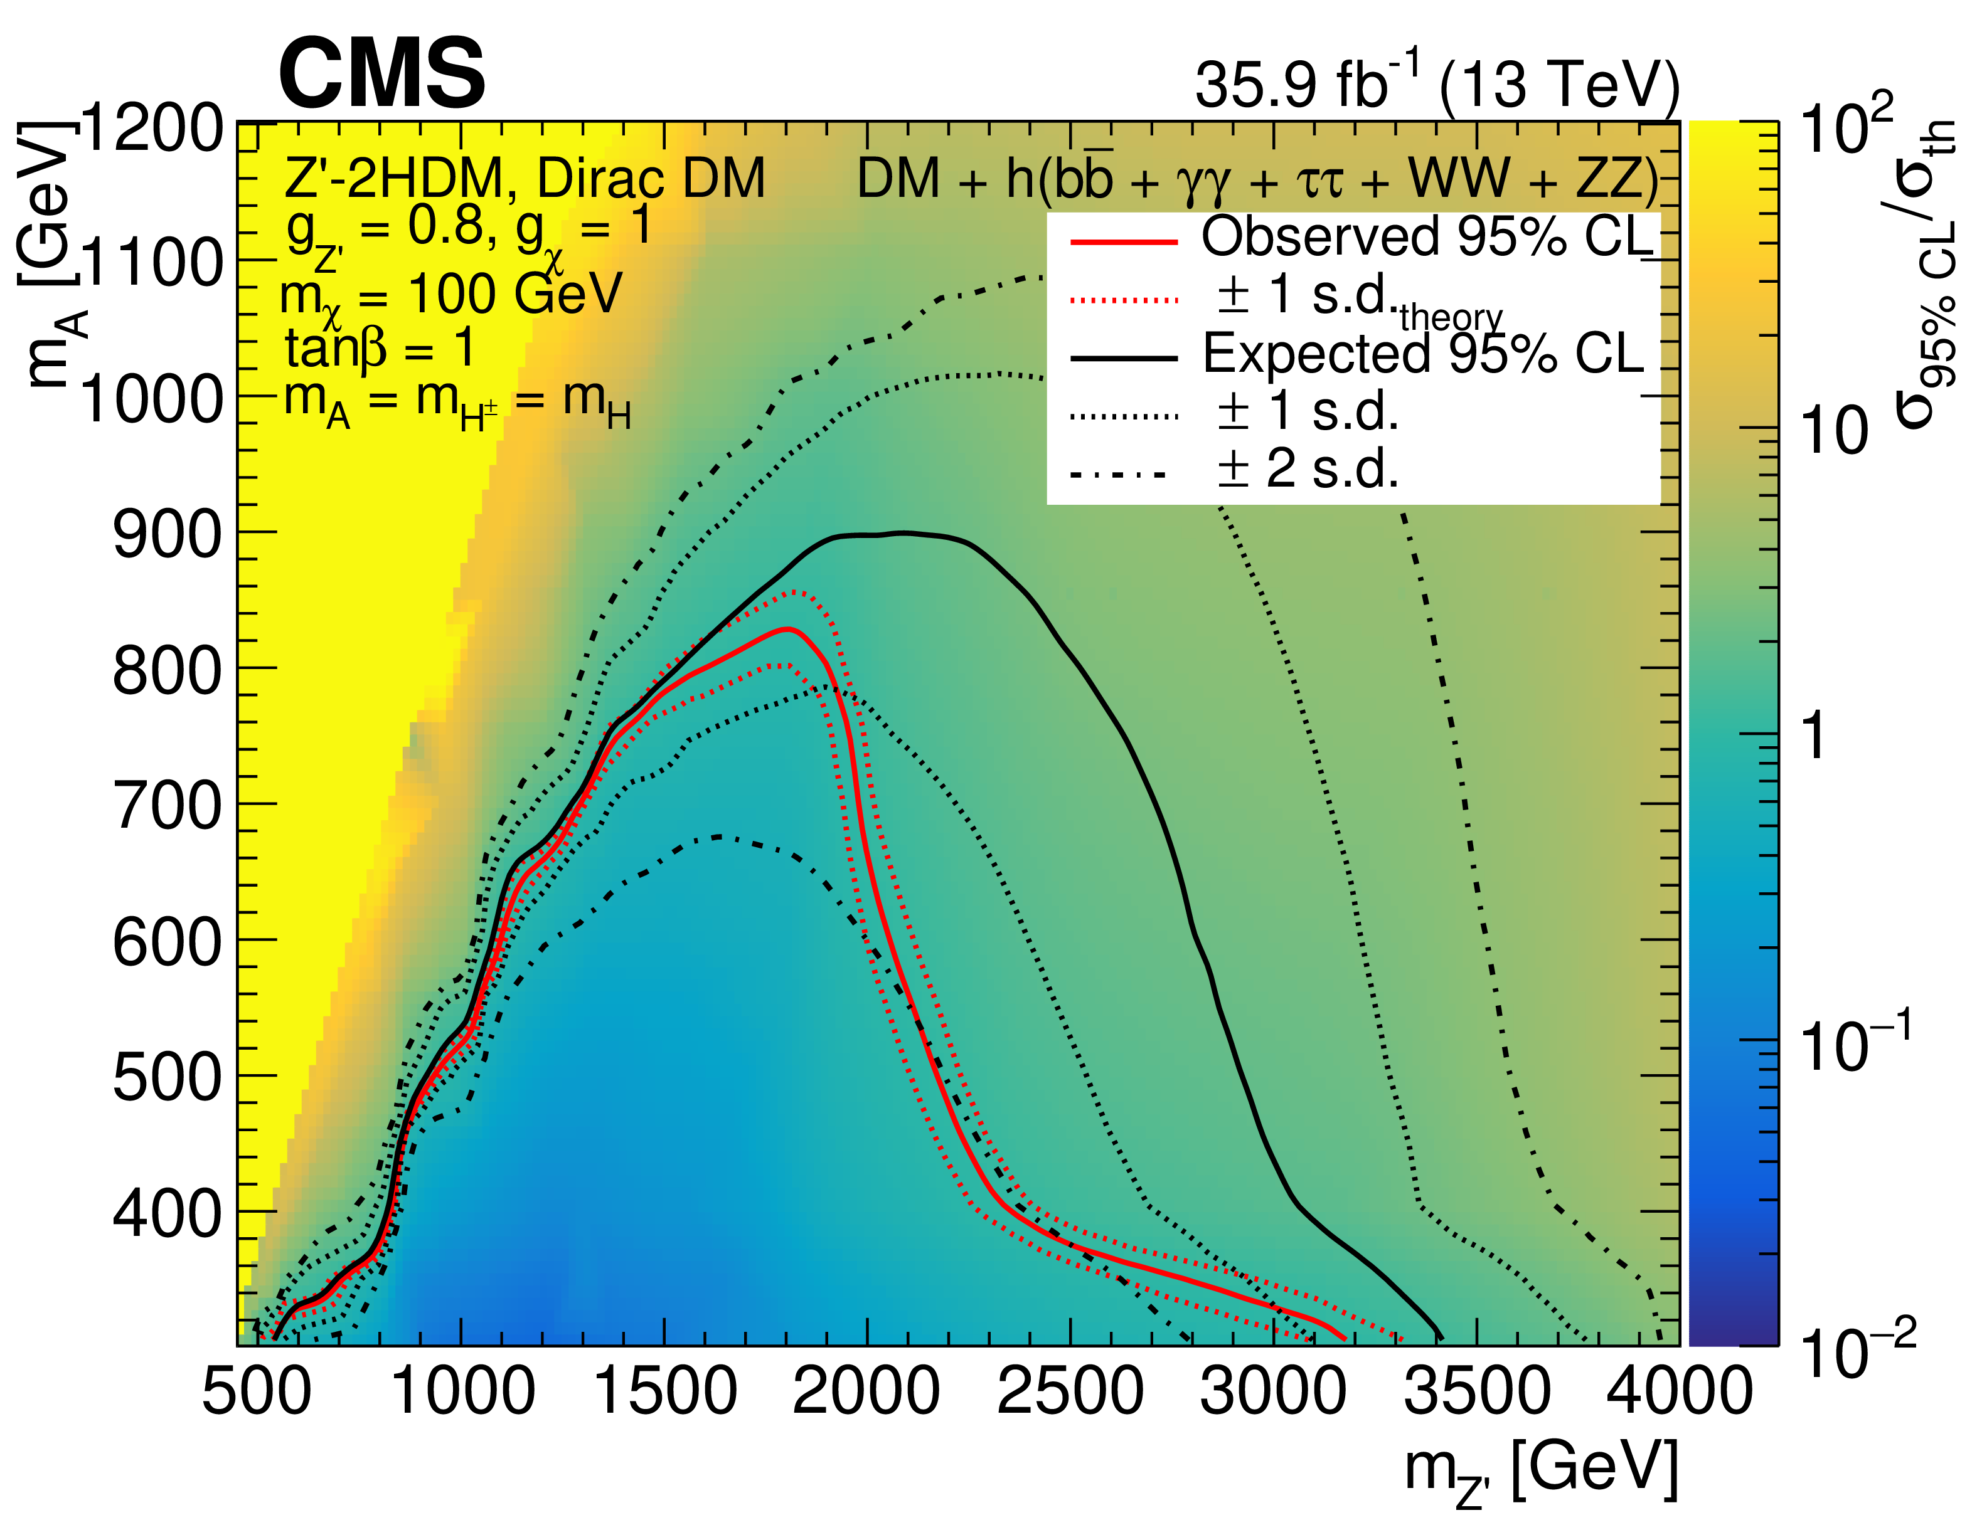
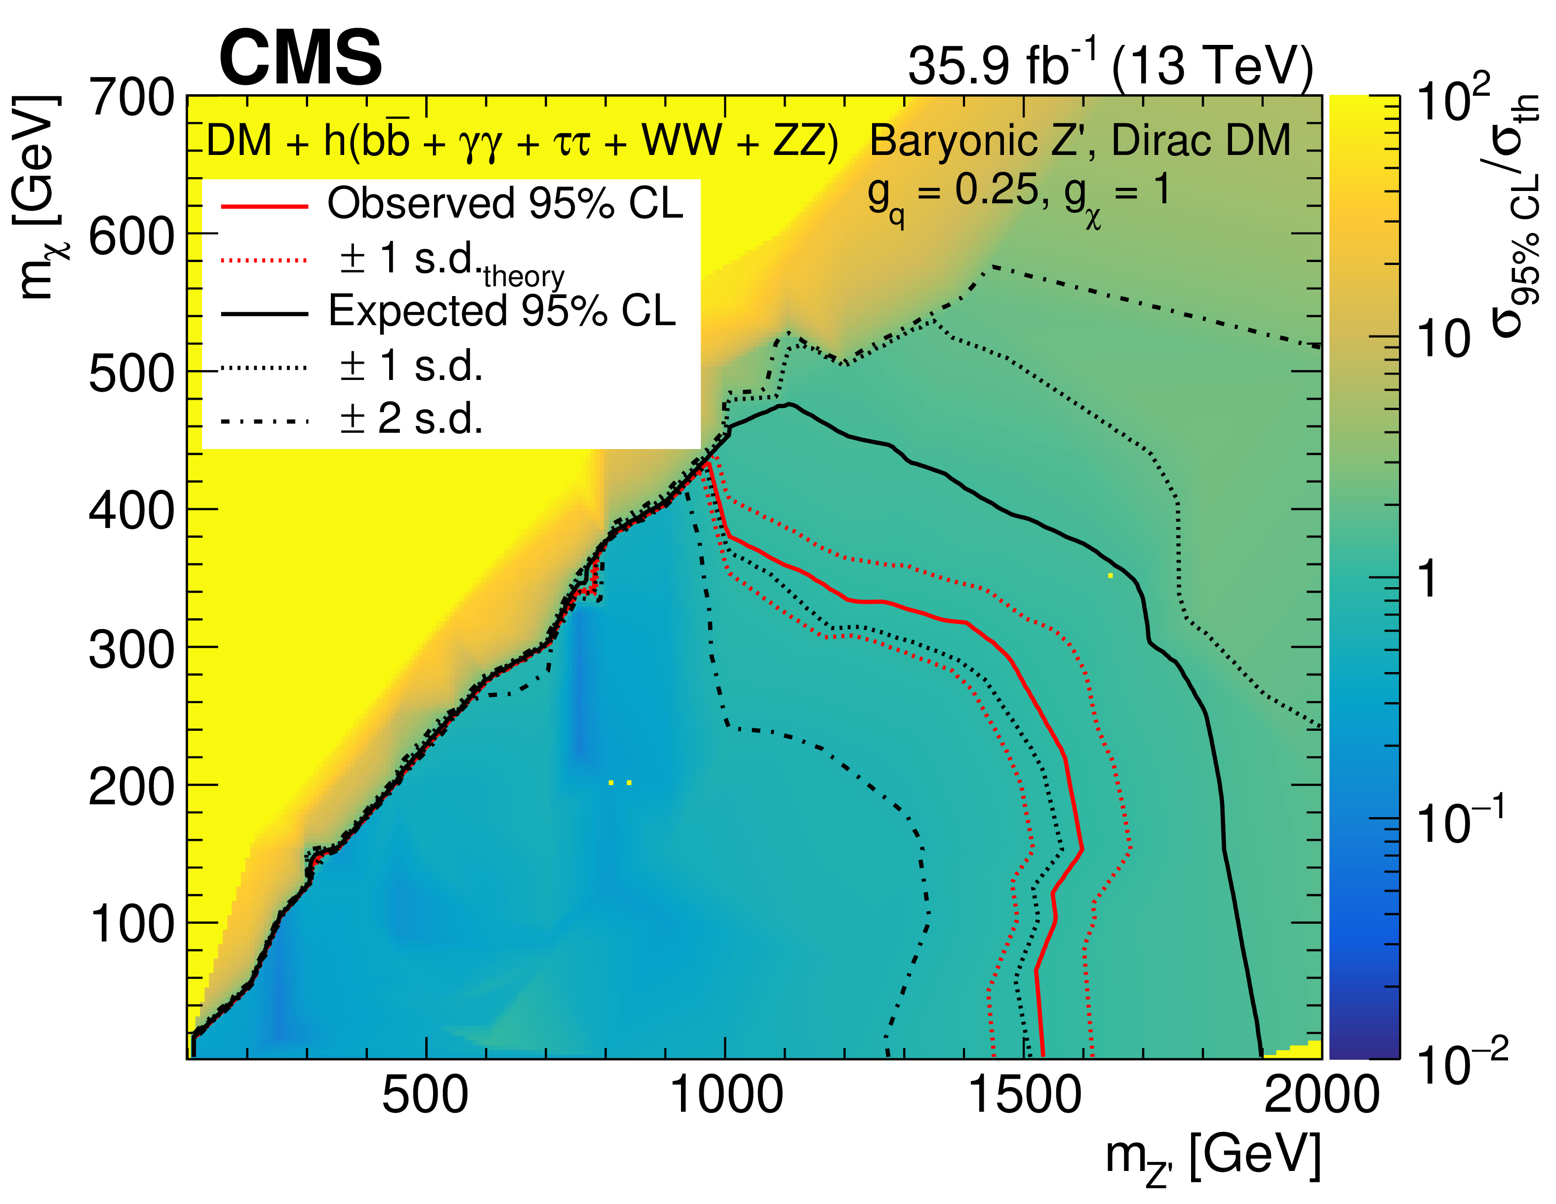
Mono Higgs ($→bb$, $γγ$,ττ, ZZ,WW) + MET
Combined Results
Interpretation: Z’-2HDM
Interpretation: Z’-Baryonic
JHEP 2003 (2020) 025

Slide 24
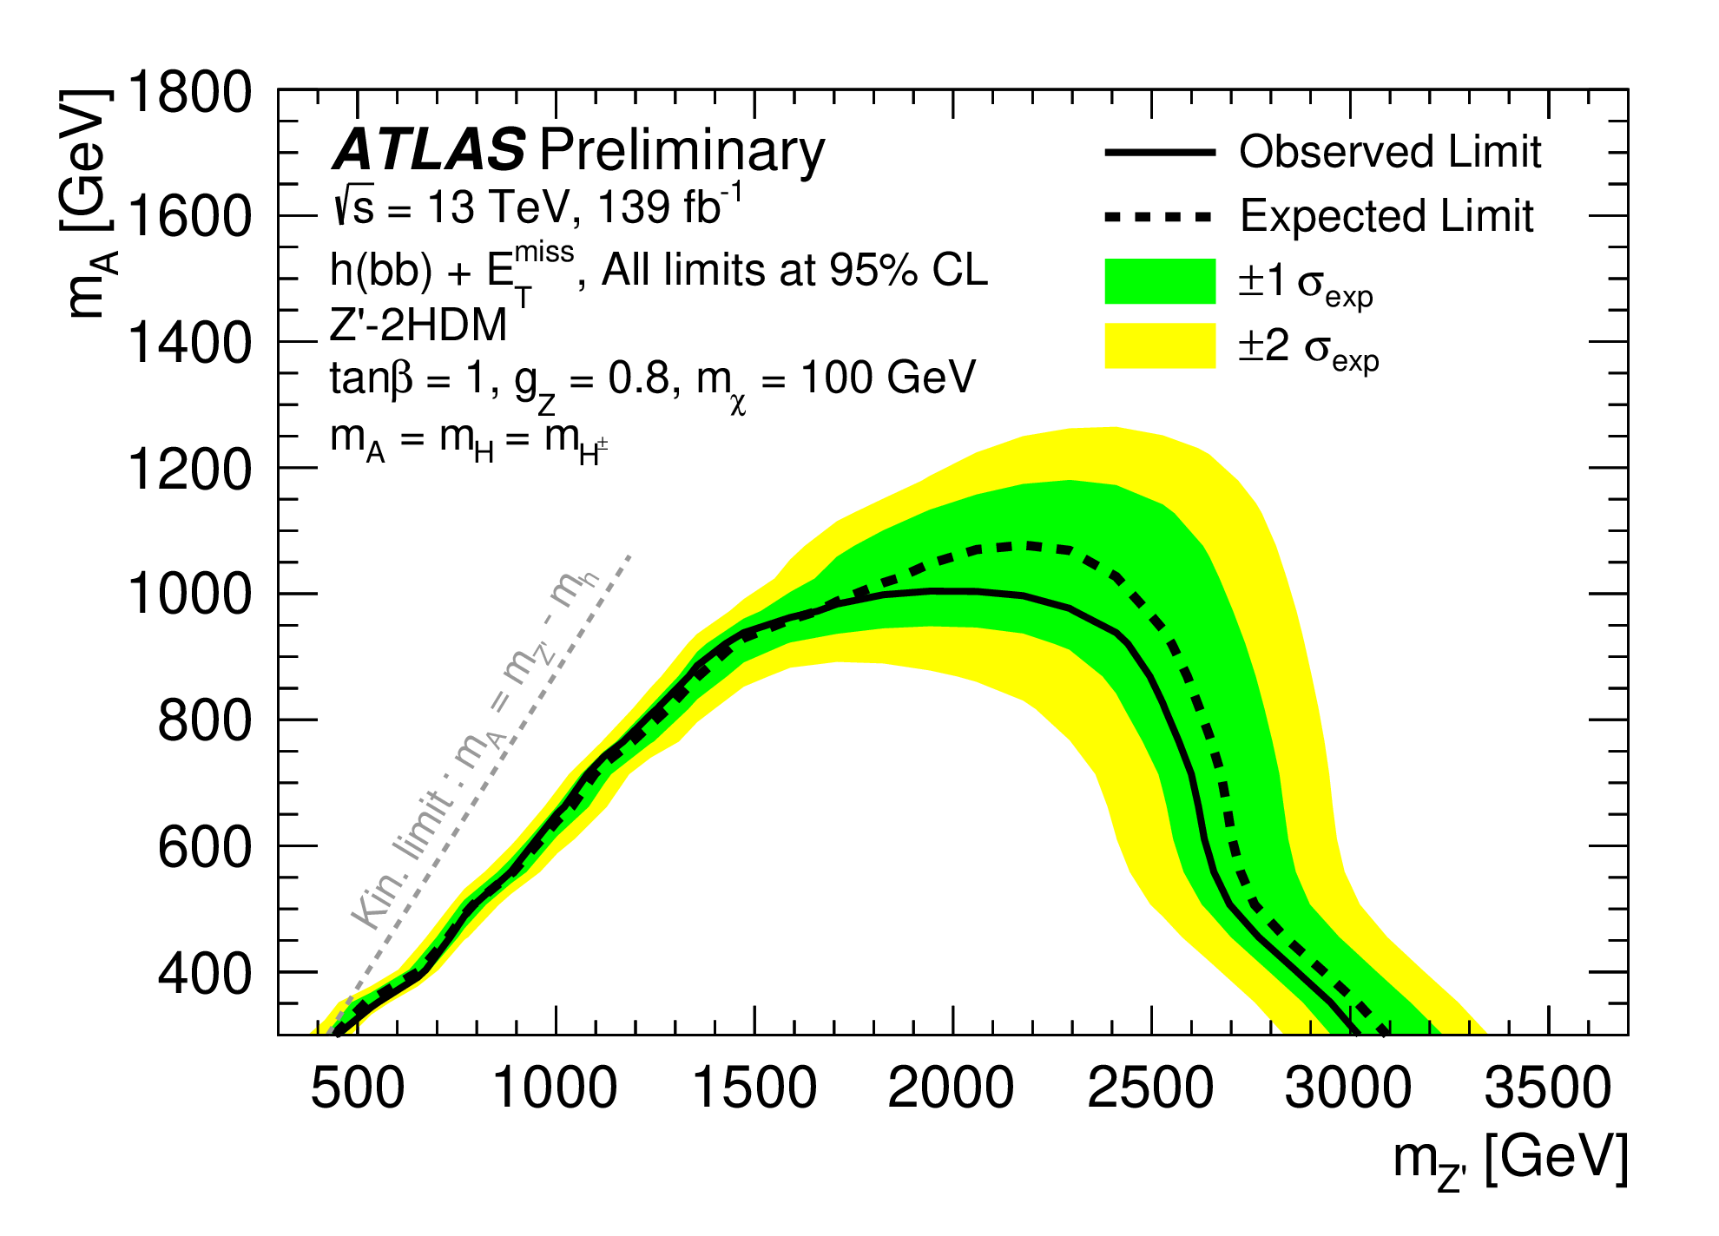
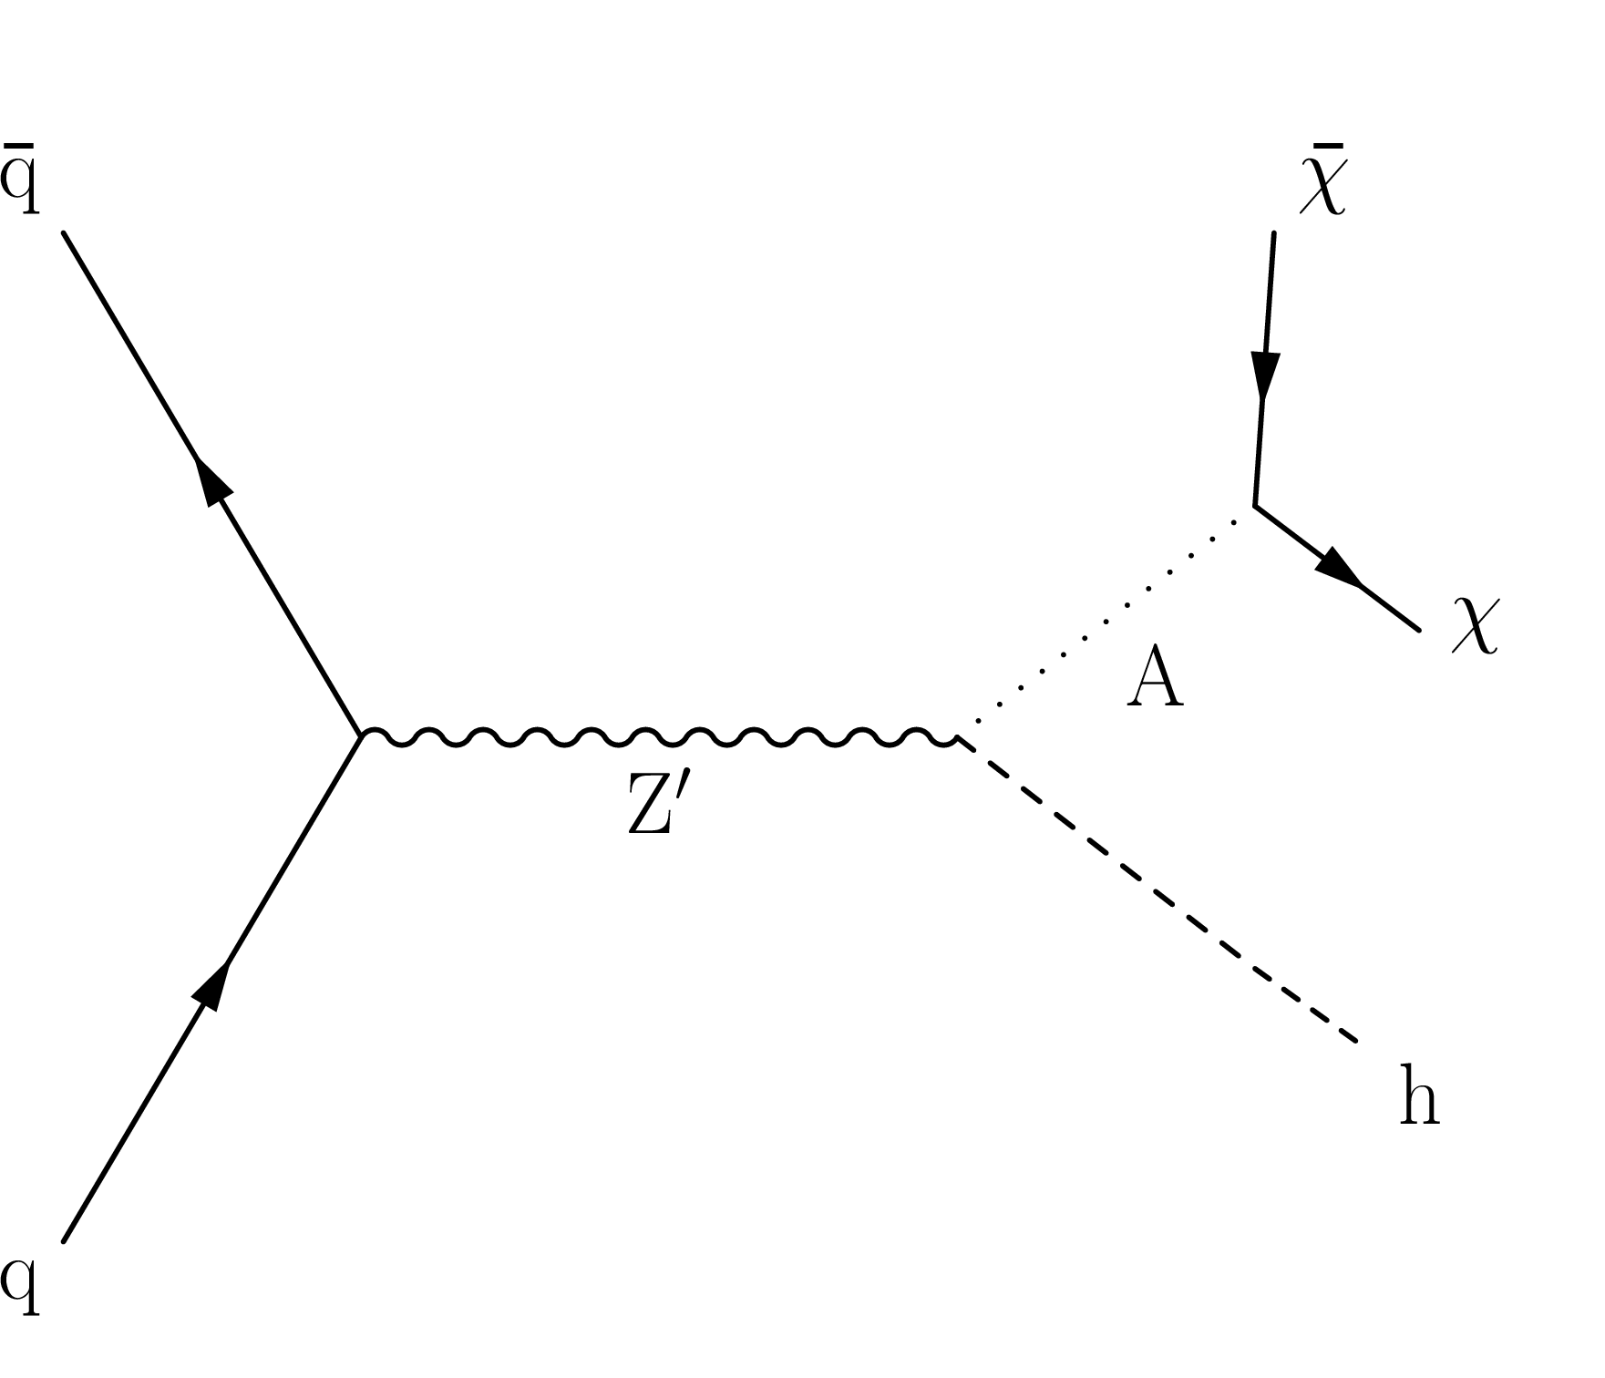
Mono Higgs ($→bb$, $γγ$,ττ, ZZ,WW) + MET
Results: ATLAS vs CMS
Interpretation: Z’-2HDM
JHEP 11 (2021) 209
JHEP 2003 (2020) 025

Slide 25
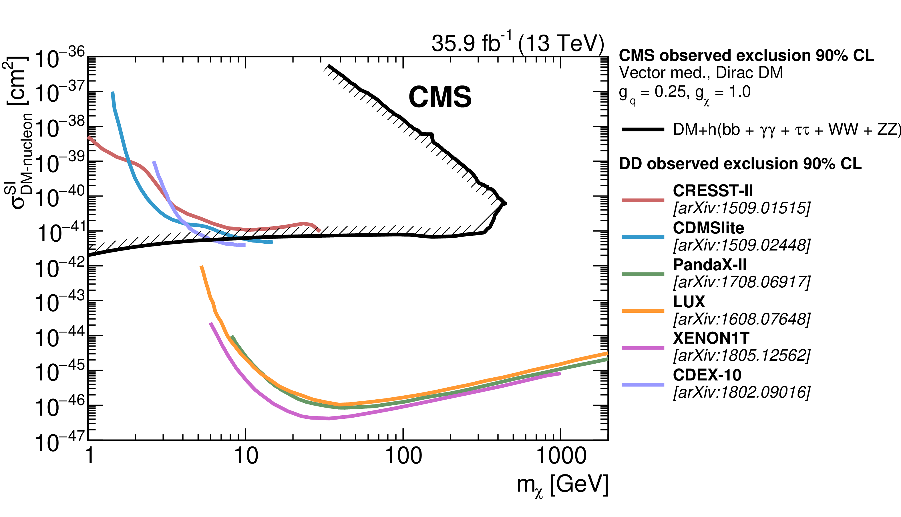
Mono Higgs ($→bb$, $γγ$,ττ, ZZ,WW) + MET
Results: CMS Vs Direct Detection Experiments
JHEP 2003 (2020) 025

Slide 26
Outlook
LHC Run 3 is going on. It will add ~150 fb⁻¹ data.
HL-LHC in the horizon. Expected to go up to integrated luminosity 3000 fb⁻¹
Exiting times ahead!

Slide 27
Thank you!

Slide 28
Extra Slides

Slide 29
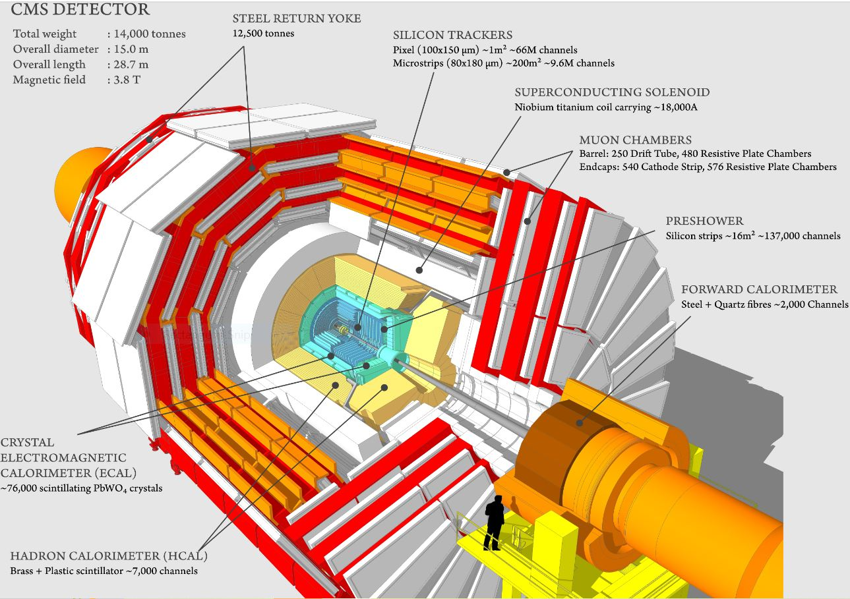
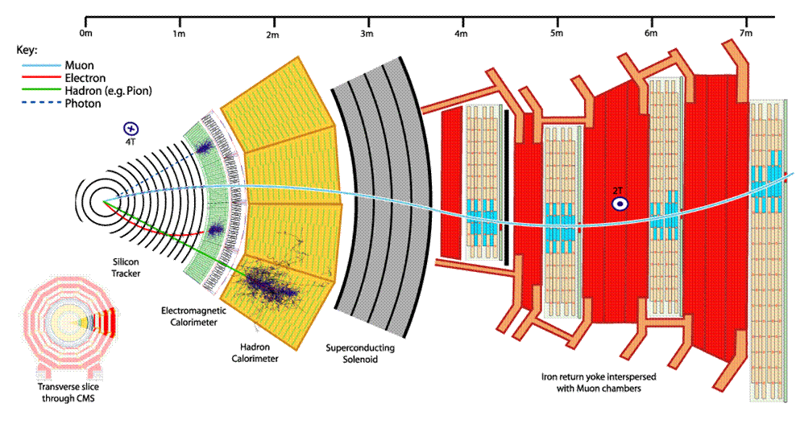
CMS Detector at LHC
https://cms.cern/sites/default/files/2022-06/detector_stripe01-min_0_0.jpeg
https://cmsexperiment.web.cern.ch/sites/default/files/cms_160312_02.png

Slide 30
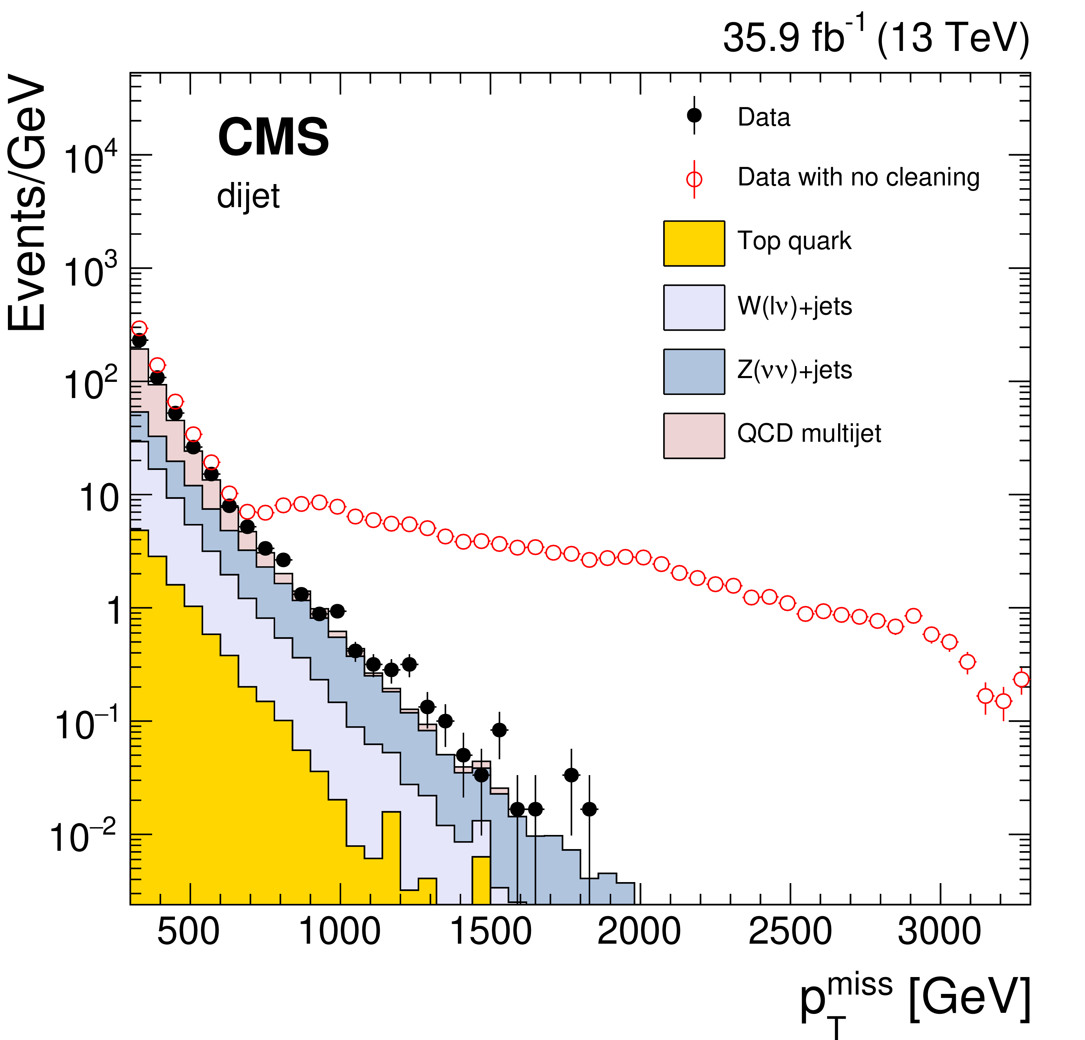
MET Reconstruction
A.M. Sirunyan et al 2019 JINST 14 P07004

Slide 31
Mono Higgs ($→γγ$) + MET

Slide 32
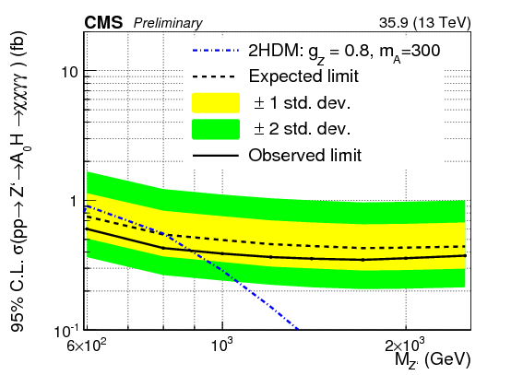
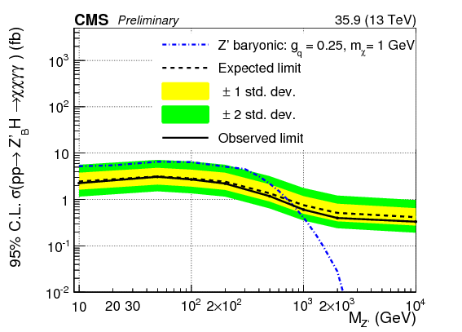
Mono Higgs ($→γγ$) + MET (35.9 fb⁻¹)
Results
Interpretation: Z’-2HDM
Interpretation: Z’-Baryonic
CMS PAS EXO-16-011

Slide 33
Mono Higgs ($→γγ$) + MET

Slide 34
Mono Higgs ($→γγ$) + MET

Slide 35
Mono Higgs ($→bb$) + MET
Jets Criteria

Slide 36
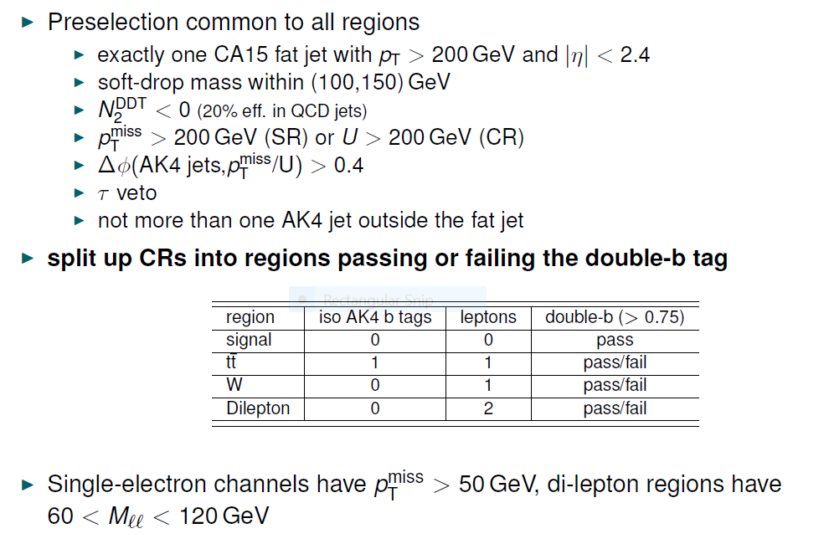
Mono Higgs ($→bb$) + MET
Event Selection

Slide 37
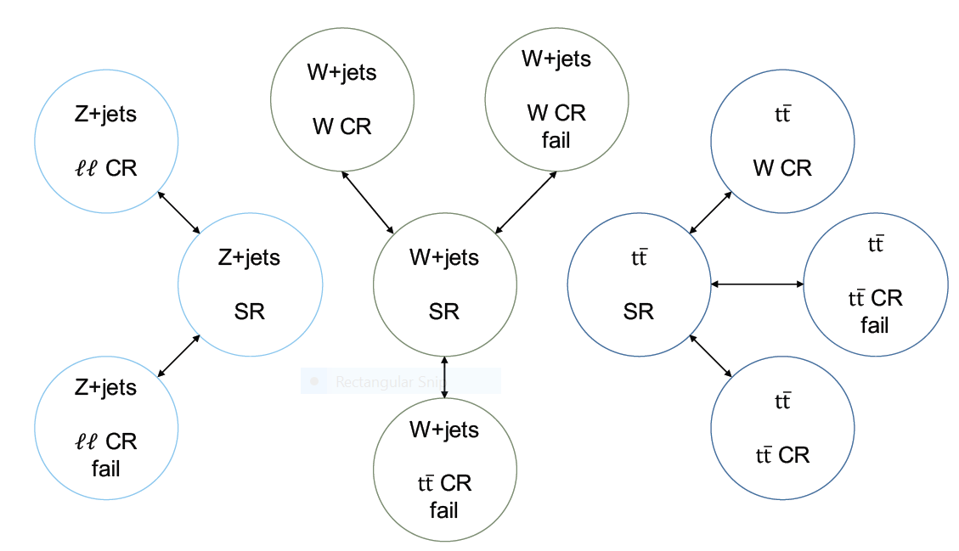
Mono Higgs ($→bb$) + MET
Background Estimation
Dominant background
$Z(→νν)$+jets
W+jets
$t\overline{t}$ production
Other backgrounds
Single top
Dibosons
SM h (VH)
Fit to p_{T}^{miss} spectrum in signal and control regions to derive upper limit on $σ×BR$ for given signal kinematics
Determine most important backgrounds ( $Z(→νν)$+jets , W+jets, $t\overline{t}$) from 6 control regions by introducing bin-by-bin transfer factors to get from shape of recoil U in CR to shape of p_{T}^{miss} in SR for specific background

Slide 38
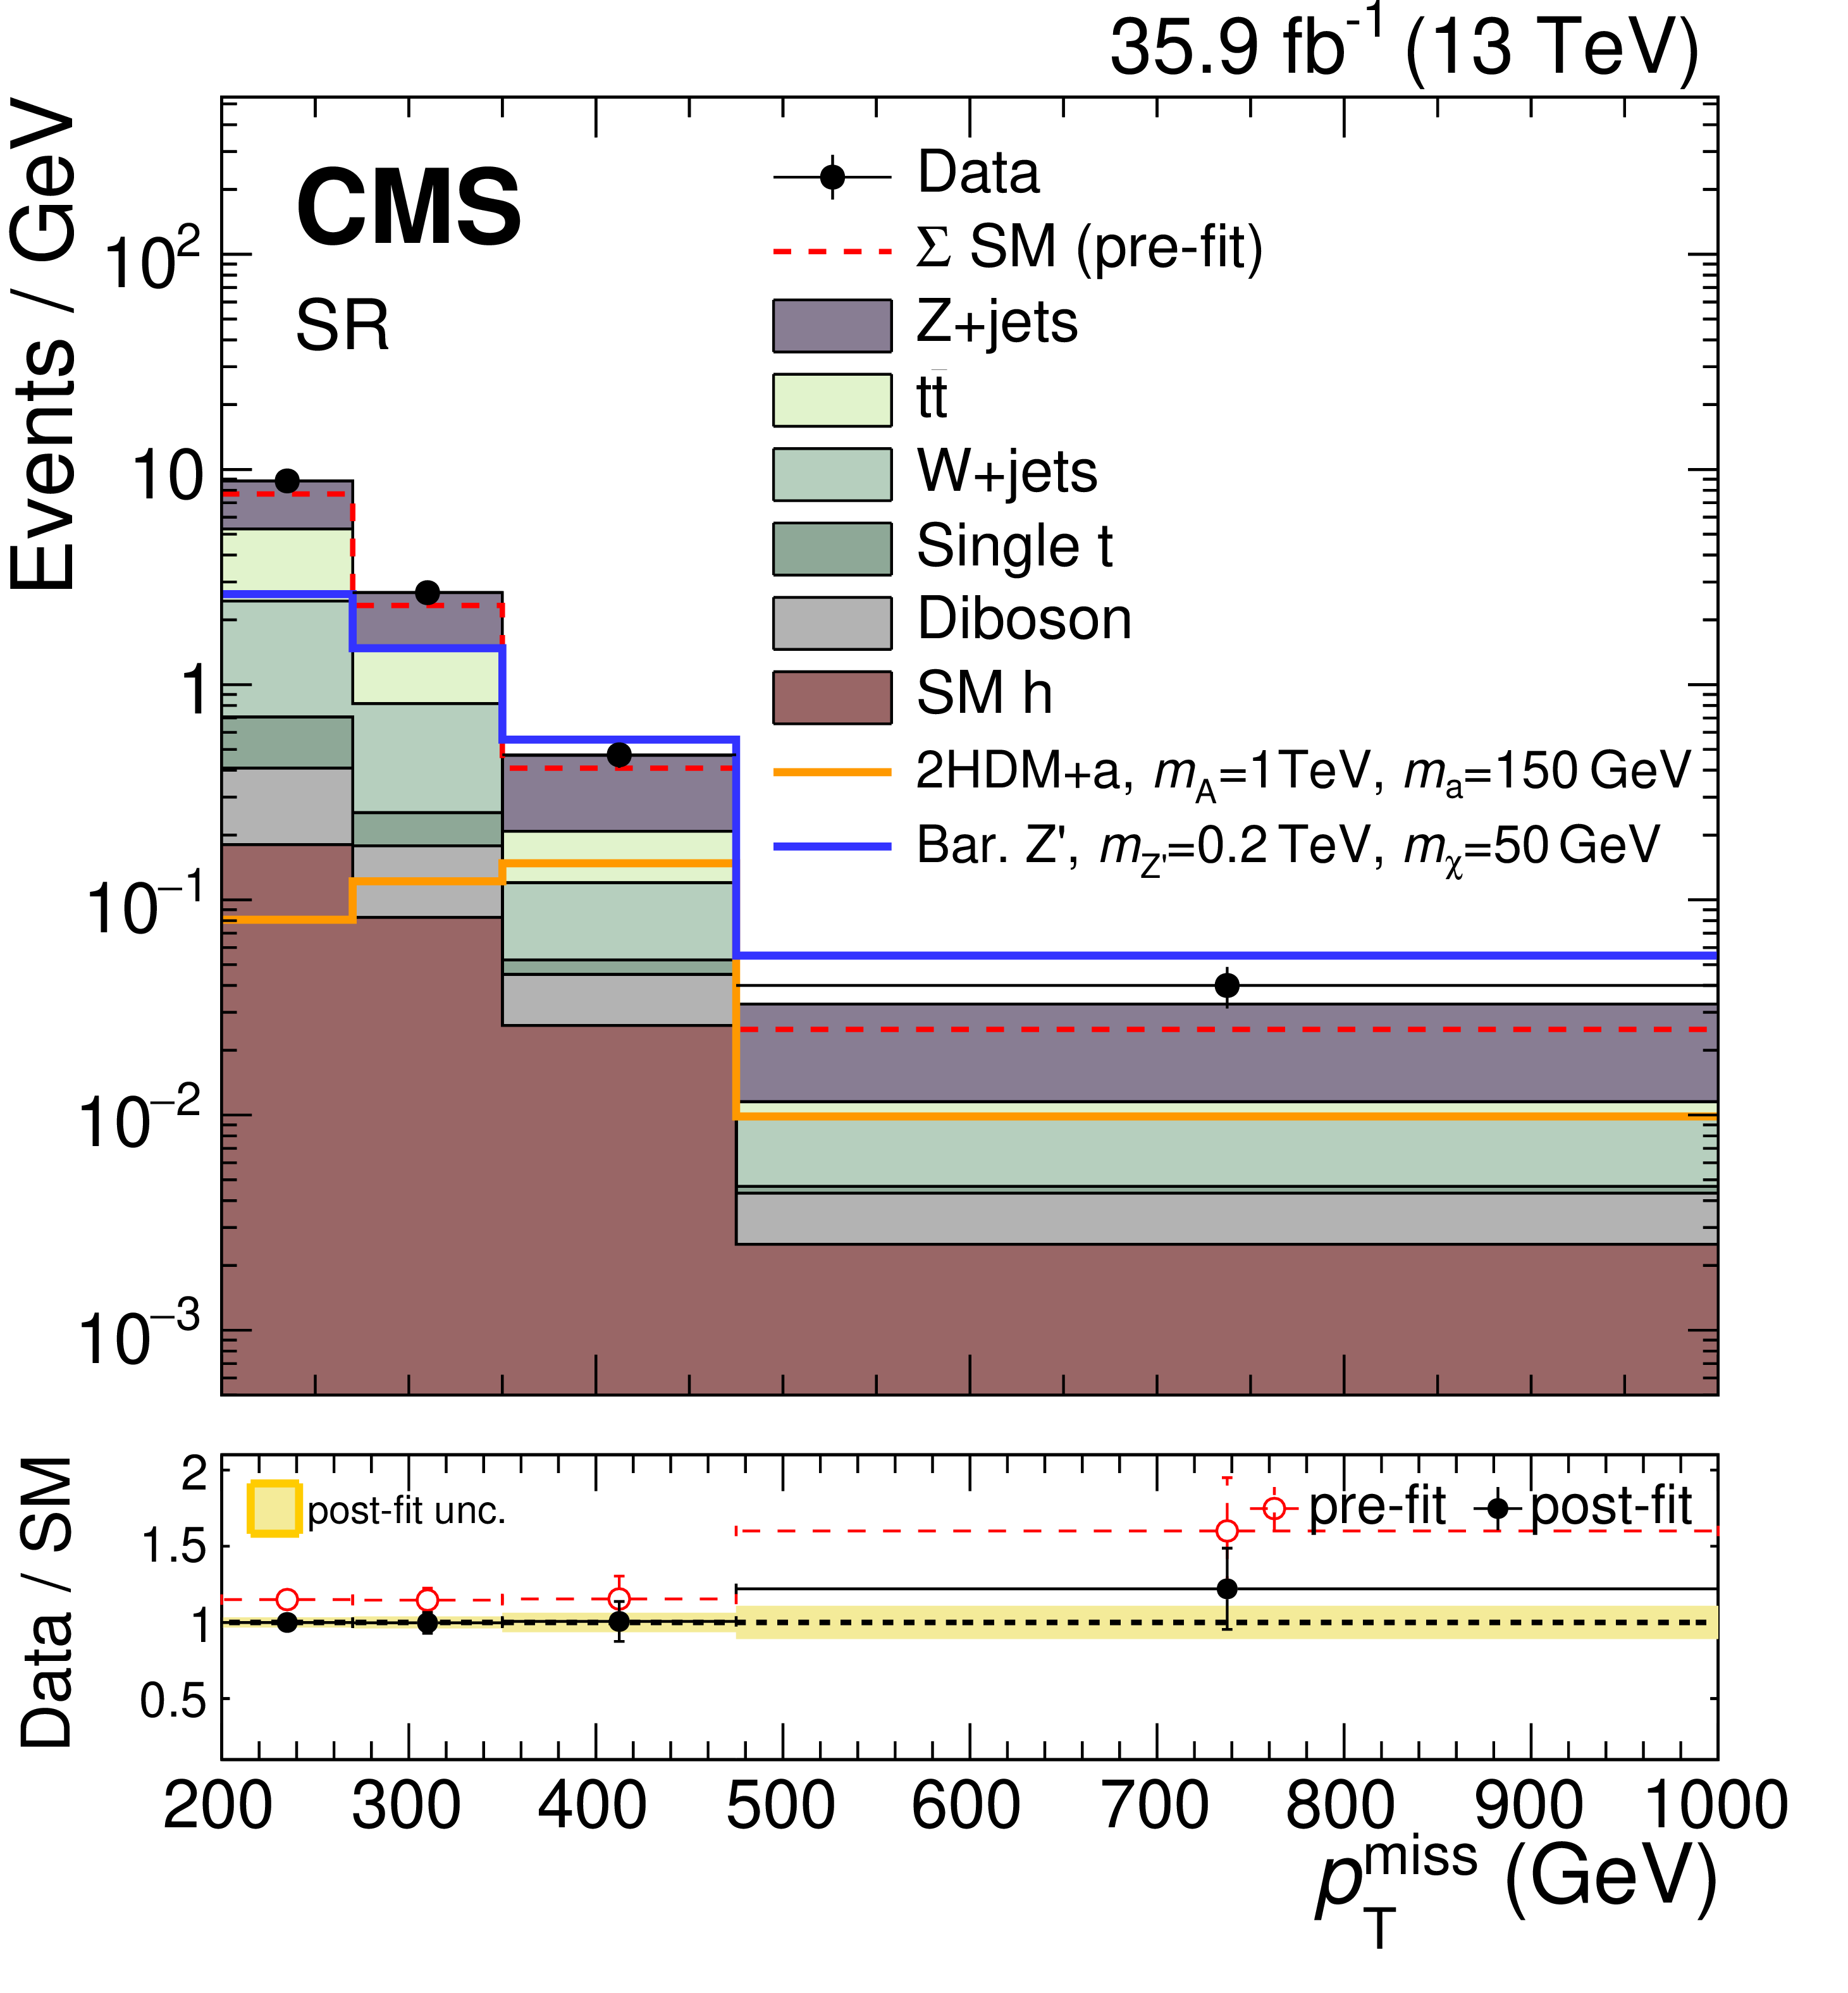
Mono Higgs ($→$bb) + MET
MET distribution in Signal Region

Slide 39
Mono Higgs ($→$bb) + MET
Background Yield

Slide 40
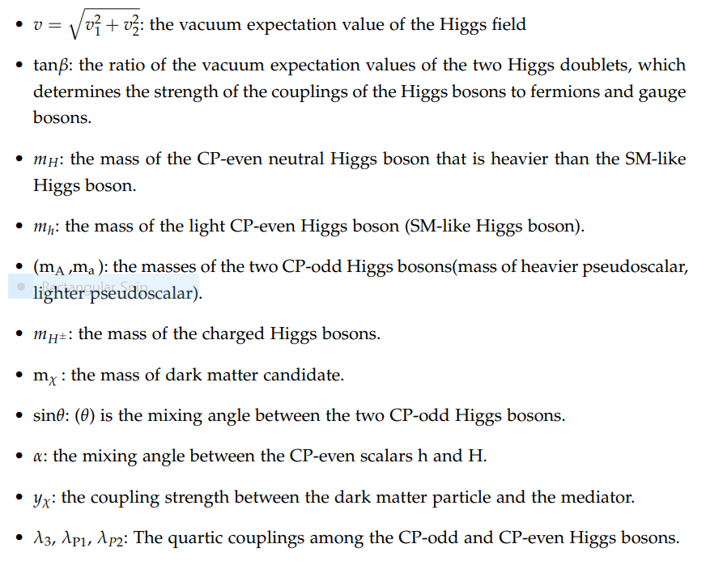
2HDM+a

Slide 41
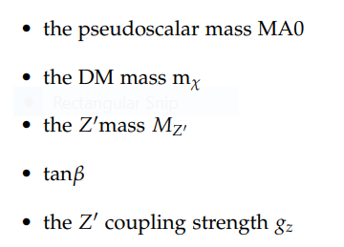
Z-2HDM

